Slide 1
Notes:
Do you ever drive down the road and then you see a yard that really catches your attention? There are many people out there who can just mow a lawn but it takes the work of a dedicated company to really catch someone’s eye. We are a premium landscape contractor that is dedicated to offering an eye-catching service.

Slide 2
Zack Quinn
11th Grade
Pathways to Technology
16 years old
Notes:
Hello, my name is Zack Quinn, I am a junior at Pathways to Technology and my company is ZAQ Landscaping.

Slide 3
Mission Statement
Provide competitively superior, quality landscape and snowplowing services at an affordable price with 100% service satisfaction guaranteed.
ZAQ Landscaping is a company that prides itself on customer service, honesty, and dependability.
Notes:
The goal of ZAQ Landscaping is to provide competitively superior landscape and snowplowing services at an affordable price with 100% satisfaction guaranteed. ZAQ Landscaping is a company that prides itself on honesty, reliability, and dependability.

Slide 4
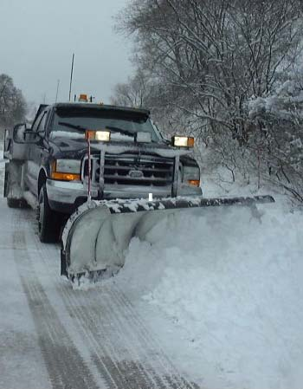
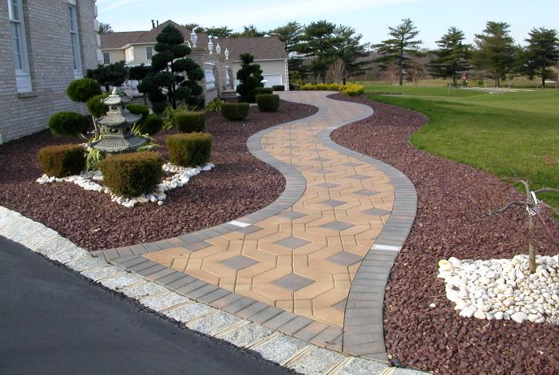
Business Profile
Type of Business
Service Business:
Landscaping: Maintenance & Construction
Snow Plowing
Some Sample Services:
-Masonry & Stonework
-Lawn Mowing & Lawn Rejuvenation
-Spring & Fall Cleanup
-Mulching, Hedge and Tree Trimming
-Landscape and Garden Planning, Design and
implementation
-Snow Plowing & Removal
Legal Structure
Limited Liability Corporation
Notes:
ZAQ Landscaping is a service business that provides landscaping, lawn care, and snowplowing services.

Slide 5
Qualifications
I:
Am Honest and Diligently Organized
Possess keen mathematical and research skills critical to estimating and accounting.
Have taken the NFTE Course
Have a mentor for both the business aspect and the work aspect.
Am an entrepreneur with 3 years experience leading and operating this company.
Have trust in the people that work for me and they have significant loyalty and trust towards me.
Notes:
I am qualified to run this business because first, I have already been successfully operating it for three years. Also, I have been taking an Entrepreneurship Course as a part of my High School Curriculum. Finally, and most important, I have loyal and motivated people that work for my company.

Slide 6
Market Analysis
Industry Name | Landscaping
Industry Size | $50 Billion a Year
Total Population
I plan to market my services to the Harford County. Its population is 877,393.
877,393
Target Market
I am targeting private homeowners, institutions, and commercial businesses including real estate companies.
250,000
Potential Market Size
About 35% of my target market would hire a landscape or snowplow service.
87,500
Notes:
Landscaping is a $50 billion dollar a year industry. My business is geared towards private homeowners, churches, and commercial businesses. Out of 877,000 people in the Hartford County, my potential market is about 87,000.

Slide 7
Target Market
Geographics
- The Hartford County
Demographics
- Adults who want a great looking yard but do not have the time to do the work themselves.
- Adults who are physically unable to do the work
By Income
- Different income levels will determine which and how many of my services are purchased however, the high quality of service will be consistent throughout.
Notes:
My consumers are in the Hartford County. They are adults who do not have the time for yard work and also businesses who want to promote their business by displaying beautiful landscaping. Consumers in lower end neighborhoods may not purchase as many of my services as other people but they still will receive the same high quality service.

Slide 8
Competitive Advantage
Competitor | Price | Quality | Greatest Strength | Greatest Weakness
ZAQ Landscaping | Affordable | High Quality | Affordable Price Fully reliable Affordable Price | Not able to work during the weekday (school year)
Bluestone Landscape | Expensive | High Quality | 25 years experience | Very expensive
Homeowners | Free | Average | Free | Lack of landscaping knowledge
Notes:
I am competing against other landscaping companies such as Bluestone Landscapes but also private homeowners. Bluestone has been around for almost 25 years and they offer a quality service yet they are very expensive. Homeowners may do their own yard work to save on costs but their own service will not be as good as a professional service. ZAQ Landscaping offers the best mix with superior quality and affordable pricing.

Slide 9
Marketing Mix
Marketing
Mix
Price
Place
Product
Promotion
People
Homeowners and Commercial Businesses
Reasonably Priced
-Website
-Referrals
-Flyers
-Door hangers
Landscape and Snowplowing Services
Hartford County
Notes:
9
I am marketing my Landscape and Snowplowing services to residents and institutions in the Hartford County. I will promote my business over the internet, flyers, and advertisements in newspapers.

Slide 10
Marketing Plan
Awareness
Purchase
Retention
Distribute flyers
Advertisements in local newspapers
Promote my website
Referrals and Word of Mouth
Portfolio of previous work
Letters of reference
Referrals and Word of Mouth
Be honest, dependable & reliable
Distribute customer satisfaction surveys
Focus on retaining clients rather than gaining new ones.
Notes:
I will gain the public awareness of my company by advertising in the local newspaper and by distributing flyers to individual homes and business. People will be inclined to purchase my services after they have seen a portfolio of my previous work. Customer retention is a priority in my business and therefore I will provide a great service but more importantly be reliable.

Slide 11
Cost Of Materials/Labor
Definition of One Unit | 1 worker hour
Direct Labor (Labor Cost per Hour) | $10.00
Fuel | $2.50
Total | $12.50
Notes:
11
One unit of sale is 1 worker hour. My direct costs are $10 for labor and $2.50 for fuel which gives me a total cost of $12.50 per unit.

Slide 12
Economics of One Unit
Definition of One Unit | 1 worker hour
Selling Price per Unit | $ 35.00
Direct Labor per Unit | $10.00
Fuel | $2.50
Total COGS per Unit | $12.50
Contribution Margin | $22.50
Notes:
I sell one unit for $35.00. After my costs of $12.50, my gross profit is $22.50 per unit.

Slide 13
Monthly Fixed Costs
Type of Fixed Cost | Monthly Cost
Entrepreneurial Stipend | $925.00
Insurance | $150.00
Salaries of Employees | $0.00 (Independent Contractors)
Advertising | $100.00
Interest | $0.00 (No loans)
Maintaining Equipment | $50.00
Utilities (Cell phone & internet) | $75.00
Auto Loan | $300.00
Other Fixed Costs | $50.00
Total Monthly Fixed Costs | $1,650.00
Notes:
After paying myself and other expenses such as insurance, advertising, and utilities, my monthly costs are about $1,650.

Slide 14
Time Management
Business Schedule for a Typical Week
Entrepreneurship | 30 Hrs.
School Hours | 50 Hrs.
Sleep | 50 Hrs.
Free-Time Hours | 38 Hrs.
Notes:
I plan to spend 40 hours a week on my business. This gives me enough time to work and complete all the neccesary paperwork including billing and expense recording.

Slide 15
Monthly Sales Projections
Break-Even Units
74
Total Units
2,880
Notes:
I had predicted that sales would be low between November to February but during this year, my sales were over 3 times what I had predicted. Spring also came early compared to last year and I started providing services in April. Sales will still be highest during the summer months of June to September.

Slide 16
Projected Yearly Income Statement
Selling Price Per Unit | $ 35.00
# of Units Sold | 2,880
Total Sales | $ 100,800
Total COGS | $ 36,000.00
Gross Profit | $ 64,800.00
Yearly Fixed Costs | $ 19,800.00
Other Costs/Unforeseen | $ 10,000.00
Total Fixed Costs | $ 29,800.00
Profit before Taxes | $ 35,800.00
Less Estimated Taxes | $ 8,950.00
Net Profit | $ 26,850.00
Notes:
I predict to sell 2,880 units per year at $35 per unit. This brings me $100,800 in gross revenue. After direct cost of goods, and all other expenses, my net profit will be $26,850.

Slide 17
Start-up
Investment
Item | Cost
Mower | $1000
Trimmer | $100
Blower | $150
Trailer | $400
Flyers | $50
Total Investment | $1,700
x
=
Notes:
I have already started my business in 2008. However when I first started, I had to buy equipment and advertise with a startup investment of $1,700.

Slide 18
Return
…on Investment
176%
1st Year Net Profit
$3,000
=
$1.76
(dollar equivalent)
Start-Up Inv.
$1,700
…on Sales
27%
Annual Net Profit
$26,850.00
$0.27
(dollar equivalent)
=
Total Sales
$100,800
Notes:
During my first year, I had a 176% return on investment. I predict to have a 27% return on sales during this year.

Slide 19
Financing
$600 from personal savings
$1,100 loan from my parents
Notes:
My financing came from $600 from my personal savings and an $1100 loan from my mother.

Slide 20
Philanthropy
Donate 5% of total profit to Food Share, a local non-profit company that distributes food to those in need.
Donating is a large part of business ethics.
We will place the FoodShare logo on our invoices to let customers know that they will be making a donation with every payment.
Notes:
My company will donate 5% of its total profit to Food Share, a local non-profit company that distributes food to those in need. I have been personally donating to this organization for seven years and I feel that as my business profits increase, I will give to others in need. We will place the FoodShare logo on our invoices to let customers know that they will be making a donation with every payment.

Slide 21
Business & Personal Goals
Business
Personal
Guarantee customer satisfaction by keeping up my quality and maintaining proper communication.
Add more customers.
Gain addition revenue streams and work with subcontractors.
Continue my business education
Intern at companies where I can experience the daily duties of an Engineer and a Business Person.
Short Term
Continue to grow as long as my mission and operating values are being met.
Go national by starting a franchise.
Attend college to study Business and Engineering.
Use my engineering education to design a product and my business education to market it.
Long Term
Notes:
In my business, I plan to gain more customers and grow my revenue. Later I plan to start a franchise and go national. I personally want to go on to college to study Business and Engineering.

Slide 22
“ZAQ Landscaping,
treating your home or property as if it were ours.”
Thank You For Your Consideration of:

