Slide 2
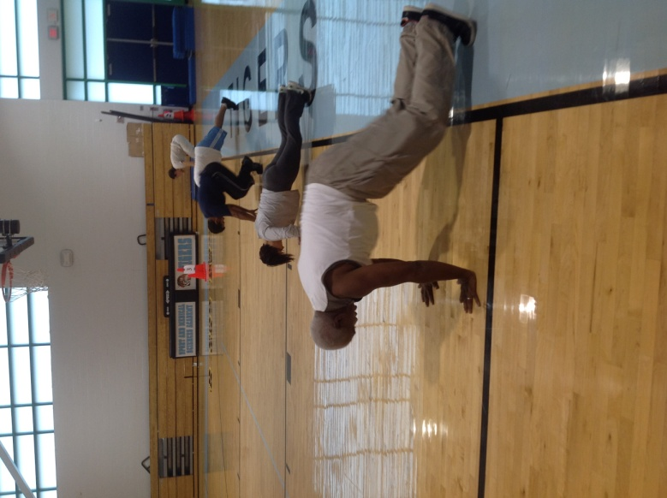
T.U.F.F
Cheyenne Capobianco
Block 1
SMSA
Notes:
Good morning ladies and gentlemen. My name is Cheyenne Capobianco and the name of my business is T.U.F.F. , Teachers Uniting For Fitness.

Slide 3
Notes:
20% percent of children in America are overweight and 65% of adults. Exercise is proven to decrease stress in anyone who partakes in it. One of the main reasons people choose other activities over exercise is their just isn’t enough time. Teachers are especially stressed; dealing with kids, to meetings, grades, and families. They never have time for themselves.

Slide 4
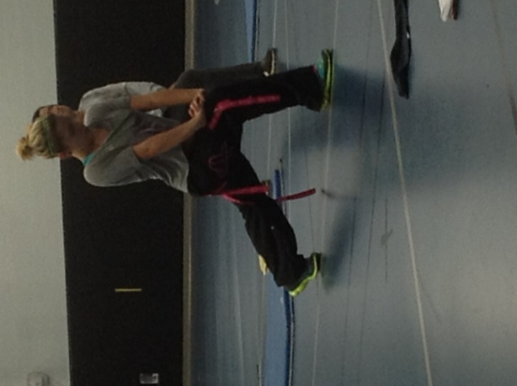
T.U.F.F
Teachers and staff uniting together and motivating each other
Atmosphere is less intimidating
Convenient location at your own school/workplace
Less expensive than an exercise studio
Notes:
Teachers Uniting For Fitness is a welcoming environment, where people work together to have a healthier state of mind, and body. A gym can be scary, especially when you are new to fitness. Your school would be a place where you are comfortable, and you already know everyone who you will be with. You never have to leave your work place. Your saving money on a gym membership, and on gas!

Slide 5
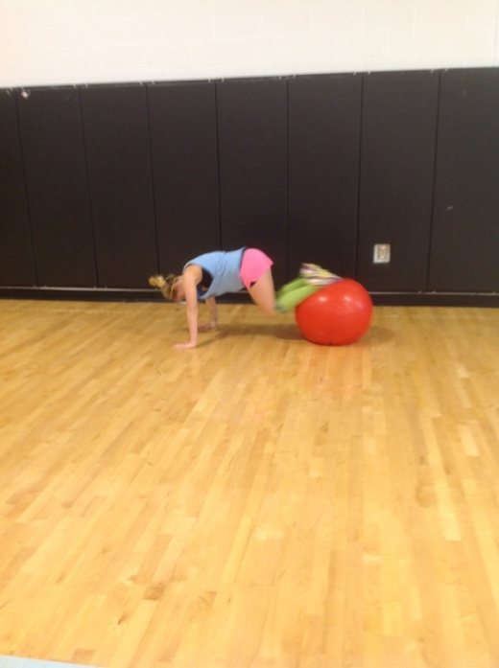
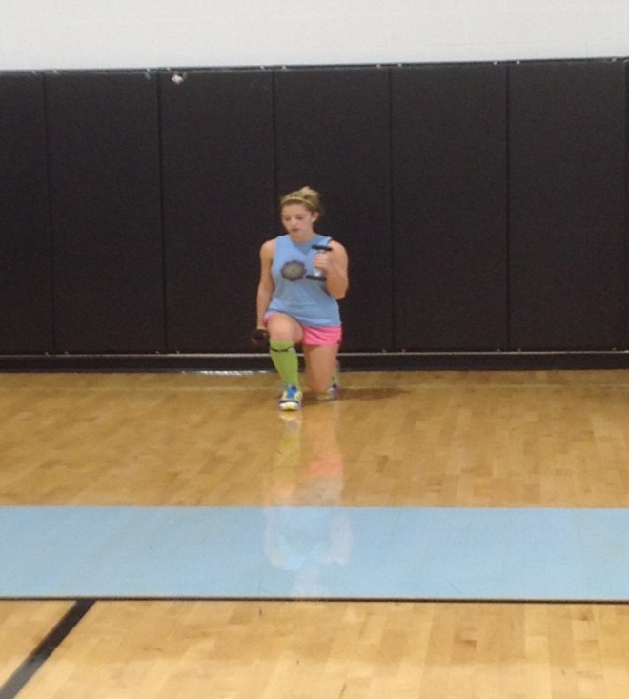
Who We Are
“T.U.F.F” work out series
Come to your school
Supportive with exercise and nutrition
Notes:
T.U.F.F. is a “tuff” work out series that will come to your school. Exercising leaves people in a better mood. Working out also makes people want to eat healthier, and exercise more. People forget how great working out makes you feel, so they don’t do it. They also don’t see it as something fun. My goal is to make it fun and enjoyable, while giving you a great work out. Who wants a grumpy teacher anyway?

Slide 6
T.U.F.F Pricing
Convenient location
All staff environment
Timing
Pricing
Definition of One Unit
6 week boot camp for 10
Economics of One Unit
Selling Price |  | $1,000.00
Cost of materials | $0.00
Cost of labor | $240.00
Other variable costs | $0.00
Total COGS/ COSS |  | $240.00
Contribution Margin |  | $760.00
Monthly Break Even Units
$240 | = | .31 | ≈ | 1 unit
$760
Notes:
My definition of one unit is a 6 week boot camp class for ten people. For this six week time period the selling price would be $1,000. I have no cost of materials because all of the materials I would be using will be taken from either the schools gym, or weight rooms. My cost of labor is $240 and no other cost of materials leaving my contribution margin at $760. I only have to sell one unit a month to break even. If teachers are interested they can do a drop in class for $10, but it would work in their favor to buy the six weeks.

Slide 7
Market Analysis
Market Statistics
Industry Name: | Fitness Center | Annual Industry Sales: | $3 Billion
Description of Target Consumer
Demographics | Geographics
Teachers in the Hartford area who want to take care of their health | Hartford, CT area
Psychographics | Buying Patterns
Understand the need for working out Want to be fit Don’t have a lot of time | Exercise twice a week
Target Market Size
Total population of targeted geographic area
124,867
Population of target market
7,500
Market size
(based on
survey)
84
Notes:
My business would be considered a fitness center, which makes 2 million dollars a year. We plan to target teachers in the Hartford area who want to take care of their health. They would be teachers who exercise twice a week, and don’t have tons of time to travel to and from a gym. My total target population is 124,867 people, this is the population of Hartford as a whole. The population of the target market is 7,500 which is just teachers and staff members in the area. I am starting to target 84 teachers, because this is the number off staff in my building.

Slide 8
Promotions and Feedback
Notes:
A lot of my marketing was done by email, here you can see some of the feedback that I got from teachers who attended one of my classes. I would send an email a day before class reminding teachers that it’s always a good day to start tuff, and encouraging them to try. I also sent an email thanking all of the teachers for their business. I would also be on the annoucments in the morning and afternoon, so the staff got a constant reminder of when class was.

Slide 9
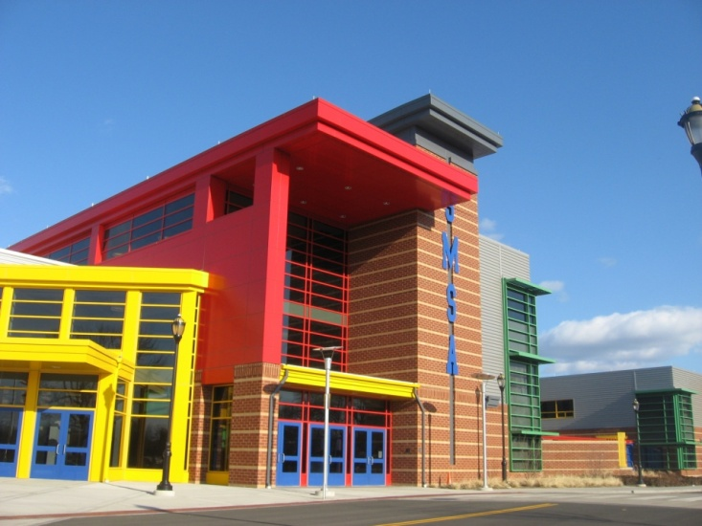
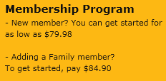
Compare and Contrast
Competition:
Gyms (Golds, L.A. Fitness)
Fitness Studios (Core, Bloom)
Home videos (P90x, Insanity)
Competitive Advantages:
Location
Environment
Timing
Pricing
$10 per class
Notes:
It is hard to compare T.U.F.F. to any kind of work out program that is out right now. The only thing that can come close to comparing to it is personal home training , or a fitness video. I say this because you can do these things at the convenient location of your home. But, they still can’t compare to T.U.F.F.. To start off, we are inexpensive compared to the other options just mentioned. With all of the money saved, you could treat yourself to a new outfit, now that you have more confidence in your body from working so hard. Also environment is key in situations like these. When you are at home by yourself, and no ones watching you, and no one is their to push you, are you really going to work as hard as you possibly can? NO! with an instructor their motivating you, you can push your body to do things you never thought it could, leaving you feeling confident and accomplished. Nothing feels better, than going home and being relaxed, because you don’t have to leave to go to the gym since your work out was done at school!

Slide 10
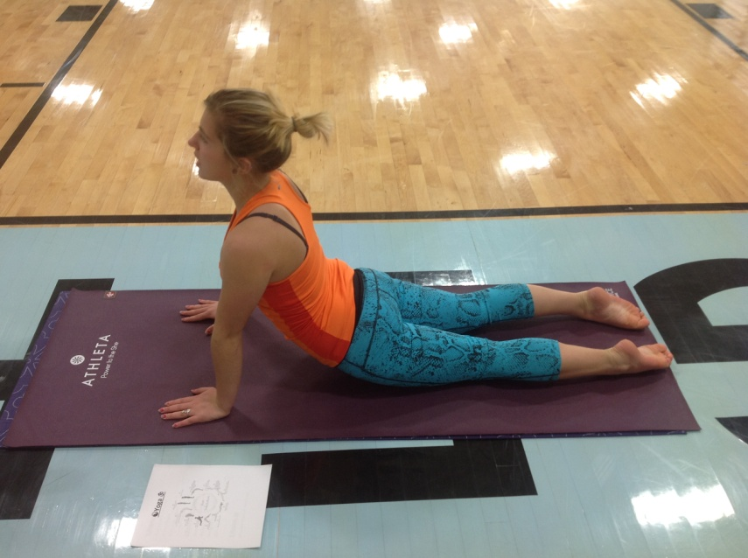
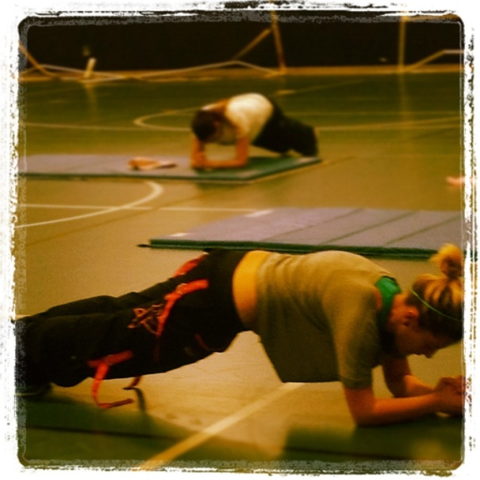
Yes I Can…..
Certified in CPR/First Aid/AED
Certified in Yoga
Family has been in fitness business for 13 years for 13 years

Slide 11
Sales Projections
Total Units
11
Gross Revenue
$11,000
Net Profit
$6,936
Notes:
Since all of my classes are pre-scheduled, I have a set number of units sold in a month. The units are higher in the earlier months of the year, because we are running more classes. Usually peoples new years resolution is to lose weight, and get in better shape. As a business, we will cater to that. In July and August there will be classes because school is not in session.

Slide 12
Startup Funds
Item | Why Needed | Cost
Laptop | Business records, and music planning | Already owned
Blank CDs (50 in a case) | Music for class | $15.00
Paperwork for LLC | File business with the state | $320.00
 | Total Startup Expenditures | $335.00
 | Emergency Fund | $167.00
 | Reserve for Fixed Expenses | $60.00
 | Total Startup Investment | $562.00

Slide 13
T.U.F.F
Thank you for your consideration…
Are you T.U.F.F enough?
Please visit us online at www.cmcapo22.wix.com/tuffteachers

