Slide 1
Notes:
So let me ask you...How safe is the internet? On December 8th, an under aged girl left CT to meet someone that she met online. She was found in Colorado a month later with a man aged 34. A girl in MA committed suicide from online bullying. 20% of teens have been part of cyberbullying. Another girl was killed after meeting a stranger on facebook. These are just a few of the dangers of online use. Did you know that 1 in 5 teenage girls have received an invite to meet a stranger? The shocking thing is that 1 in 10 teenage girls have actually accepted that invitation. What are we to do?

Slide 2
QuizMyTween
By Mitchell Buhler
From Pathways Academy
Of
Technology and Design
Notes:
Well, my name is Mitchell Buhler, I’m from Pathways to Technology and let me introduce you to QuizMyTween

Slide 3
Problem: Quick Facts
20 Million Children (Ages 10-14)
78% have their own device
63% know how to hide what they do online
Source: Pew Research: Teens & Technology 2013
Harris Interactive-McAfee October 2008
Notes:
The problem as I see it is that children on not educated on Internet Safety. There are 20 Million children in the US ages 10-14. Studies show that 78% have their own device and 63% know how to hide what they are doing on their device from their parents

Slide 4
Is Your Child Safe?
Filter or Block
Educate
Notes:
PROBLEM SLIDE
There are two ways to solve this, you can filter or you can educate
Filters are like fences around pools, To truly keep them safe, you teach them to swim, Empower them to make the right decision
As parents and teachers you do your best to keep driving in the point that they shouldn’t talk to strangers online, that they should let you know if someone is bullying or threatening them.
But how do you know that the point has been driven home?
How do you assess that?

Slide 5
QuizMyTween
A tool to assess
Online Safety Awareness
What's a dollar for your child’s safety?
Notes:
The answer to that problem is QuizMyTween. This is an app that quizzes and grades children and teenagers on different topics revolving around internet safety involving real life scenarios. The grading system guides the conversation an adult needs to have with that child

Slide 6
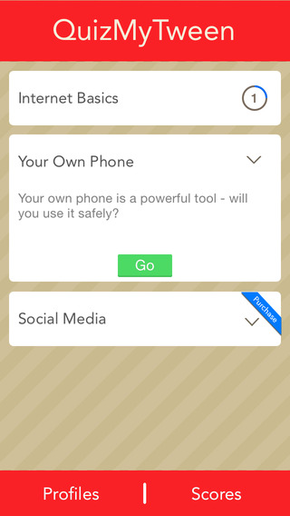
App Description(Opening)
Mobile App with a quiz
Multiple users can use the app
Quests are different events in the child's life
Notes:
When you open the app it will ask you for your age and to create and account so that multiple users can use the app
Different Quests which are equivalent to big technological events in a childs life such as getting a phone or starting to use social media

Slide 7
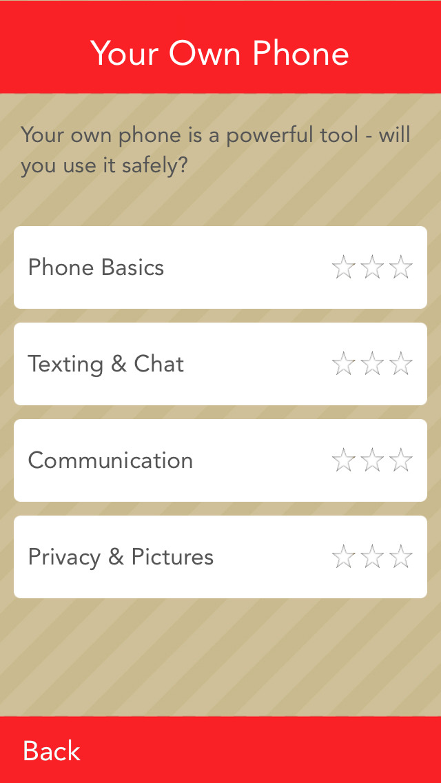
App Description(Quiz)
Questions based on real-life scenarios
Questions received from parents and education professionals
Provides safety tips to the child
Notes:
Inside those quests there are different quizzes that the child can take relating to the quest
As you can see this is the getting a phone quest because it covers topics such as phone basics and texting
When you go into a quiz, it will give you questions and you have a one minute time limit to give an answer
If the answer is wrong, the app will give you the correct answer and an explanation for why you got it wrong.

Slide 8
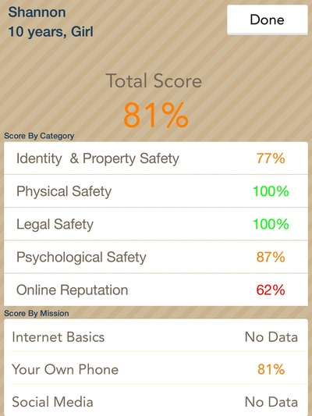
App Description(Grading)
Grades on 5 different topics revolving around internet safety
Data for the parent to focus the conversation
Notes:
The app grades on 5 different topics revolving around internet safety
As you can see, those topics are Online reputation, Physical Safety, Psycological Safety, Legal Safety and Identity and Property Safety
These topics are used to show the parents exactly what the child doesn’t know about that certain topic
This is the phone quiz and the child scored a 62% on Online Reputation which means that she doesn’t know how to act accordingly on her phone
Her parents now know that she needs to be taught an appropriate way to conduct herself online

Slide 9
Mission & Social Impact
Our Mission is to start the conversation between parents and children on internet safety
Social Impact: QuizMyTween educates children on internet safety and keeps them safe.
Notes:
Stolen Identities
Robberies

Slide 10
Business Model
Definition of One Unit
One App
Description of Expenses
Variable Material Expenses | Total: $0.33
Commission | $0.33
Fixed Expenses | Total: $470
Marketing | $225
Depreciation | $50
Insurance | $35
Utilities | $60
Salary | $100
Economics of One Unit
Selling Price |  | $0.99
Cost of var. materials exp. | $0.33
Cost of labor | $0.00
Other variable costs | $0.00
Total COGS/ COSS |  | $0.33
Contribution Margin |  | $0.66
Monthly Break Even Units
$470 | = | 712.12 | ≈ | 712 Apps
$0.66
Notes:
Laptop-1500
4 years sell for 100
1400 depreciation over 4 years
/ 4 years
/ 12 months
29
Utilites Phone Utilities

Slide 11
MARKET ANALYSIS
Market Statistics
Industry Name: | Mobile Apps | Annual Industry Sales: | $25 Billion by 2017
Description of Target Consumer
Demographics | Geographics
Parents with younger children School Administrators and Superintendents | Schools and Cities Currently focused on Hartford school system
Psychographics | Buying Patterns
People that care about their children People who are concerned about social media | Buy other child safety products
Target Market Size
Total Parents in the US
83.5 Million
Parents with children ages 10-14
36 Million
Parents that would buy the app
(based on
survey)
28.8 Million
Notes:
Laptop-1500
4 years sell for 100
1400 depreciation over 4 years
/ 4 years
/ 12 months
EXPLAIN survey on 100 people showed that 80% of parents would buy QuizMyTween

Slide 12
Competition
 | Your Business | staysafeonline.org | CommonSense.Org
Education | Educates children on Internet Safety | Educates children on Internet Safety | Lots of resources to educate children on Internet Safety
Quiz | Quizzes Children's Knowledge on Internet Safety | Doesn’t quiz at all | Doesn’t quiz at all
Type of product | An App | A website | A website
Your Competitive Advantages
1. Application is more portable and easier to give to children 2. Quizzes a child's knowledge where as Commonsense and staysafeonline just educates them

Slide 13
Marketing and Sales
Sales
Sell through the app store
Marketing
Create Facebook and Twitter pages
Buy ads on Facebook, Twitter and google

Slide 14
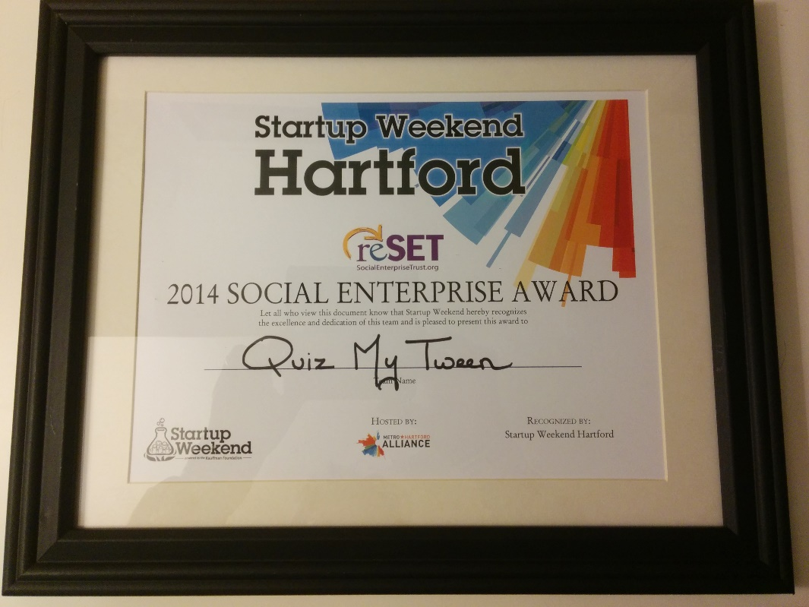
Qualifications
Currently taking Entrepreneurship
Finalist of World Series of Innovation
Winner of Hartford Startup Weekend

Slide 15
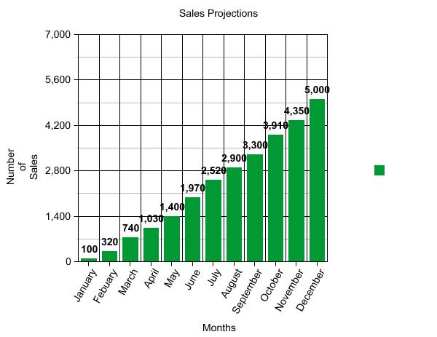
SALES PROJECTIONS
Total Units
27,540
Gross Revenue
$27,264.60
Net Profit
$12,536.40
Notes:
27264-9088.20-5640
ADD TAXES LATER

Slide 16
STARTUP FUNDS
Item | Why Needed | Cost
Business Laptop | To develop and design app | $1500
IPhone | To test and design app | $800
Business License | To make the business legal | $10
Apple Store App Dev. | So that the app can be on the App Store | $99
App Development | Outsourced app Development | $40,000
 | Total Startup Expenditures | $42,409
 | Emergency Fund | 5,000
 | Reserve for Fixed Expenses | 810
 | Total Startup Investment | $48,219
ROI: Return on Investment
$14,936.40 | = | 31% | ≈ | $0.31
$48,219
ROS: Return on Sales
$14,936.40 | = | 54% | ≈ | $0.54
27,540
Notes:
$1500 Laptop
$800 IPhone
$10 Business License
$99 Apple App Store License
$40,000 App Development
Total=$42,409

Slide 17
FUTURE PLANS
Develop an Android Version of the App
Sell to schools in discounted packages
Notes:
Sell the schools code for multiple uses

Slide 18
QuizMyTween
Is Your Child
Cyber-Smart?
Notes:
Here’s some interesting statistics:
63% of teens say they know how to hide what they do online from their parents⁶.

