Slide 1
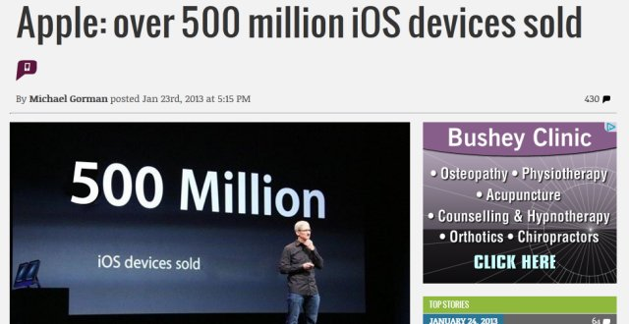
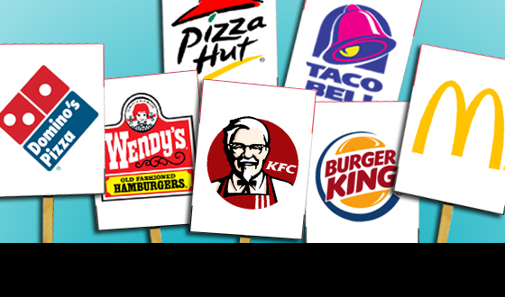
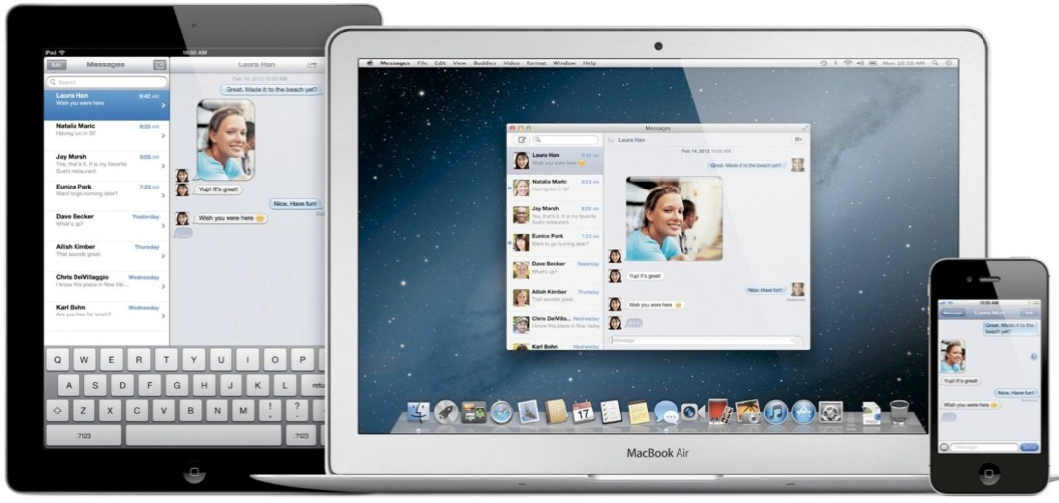
Notes:
Frances: We are now moving into an era where everything is becoming technology based. How many of you have downloaded an app in the past week? How many of you have a food related app on your phone? Over 500 million iOS devices have been sold as of early 2013, along with 50 billion downloaded apps as of June 2013.
Hannah: Food related apps are on the rise, McDonald’s, Taco Bell, Domino’s, Dunkin’ Donuts, and many more franchises have developed their own apps to promote their restaurants. Which app would you download? One, two, all of them? That’s a lot of apps to keep track of. What if you could download one app that has all of the information in one?

Slide 2
Off the chain! Your link to good eats
Frances Jaynes (17)
Hannah Nguyen (16)
11th Grade
Notes:
Frances: Hello, my name is Frances Jaynes, I am 17 years old
Hannah: I’m Hannah Nguyen, I am 16 and we are both juniors at Pathways Academy of Tech. & Design
Let us introduce you to, “Off the Chain, your link to good eats” an app created by our company, OTCi, (Off the Chain Innovations)

Slide 3
Waiting for food
Notes:
Don’t you hate it when you go to a fast food restaurant and the food isn’t fast enough? Well, he have the solution for you…
~Have to incorporate clutter… needed?~
Frances: Some issues that you run to in a day-to-day basis are long lines and cluttered smart phones. Now a days, people want everything fast and easy, especially their food; However, sometimes you have to wait 15-20 minutes for your order to be ready at a restaurant, which defeats the purpose of “fast food.” ~HAVE TO WORK IN THE CLUTTER PART; STILL THINKING~
Maybe Solution slide/Hannah: The Off the chain app can fix both problems by allowing users to order their meals beforehand and notified when to pick up their meal and holding all of the information from multiple apps in one.

Slide 4
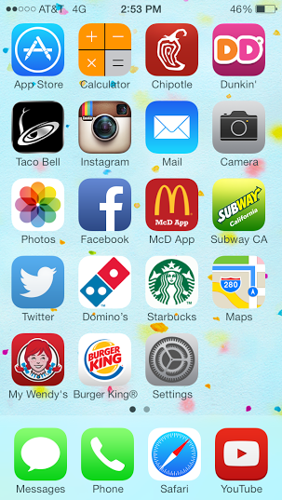
Solution: “Off the Chain,” the App
An app that:
Includes information on multiple food chains
No more downloading individual food apps!
Notes:
Our solution is Off the Chain! An app that includes information on multiple food chains in one and reduces clutter on your smartphone.

Slide 5
Mission & Social Impact
Mission Statement:
Our mission is to create an app that allows people to search, order, and purchase meals from chain restaurants.
Social Impact:
We will use our generated income to promote environmental awareness such as Grow Hartford.
Notes:
Our mission is to create an app that allows people to search, order, and purchase meals from chain restaurants.
We will use our generated income to promote environmental awareness such as Grow Hartford. Grow Hartford is a youth group with the Hartford Food System that design local based projects around the topic of food access/food justice.

Slide 6
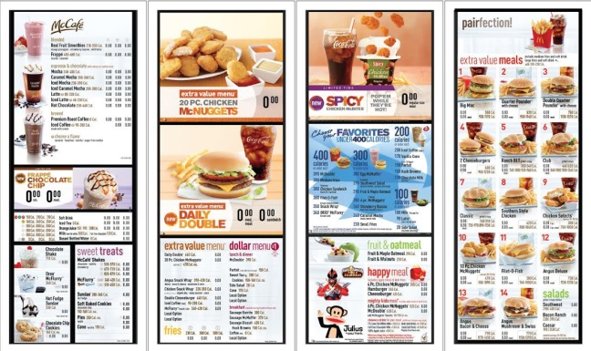
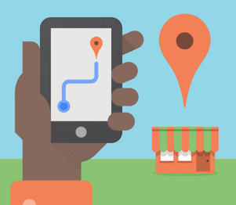
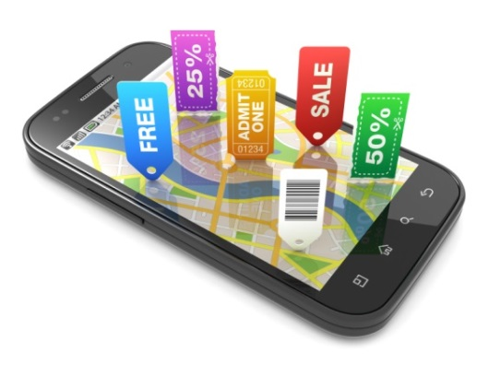
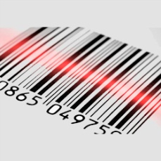
Description of Product
Off the Chain will hold the information of multiple chain establishments in one mobile app. Off the Chain will have various features such as:
Notes:
Must take out Delivery ~ Only for places who offer delivery like pizza hut, etc.
Our app includes the features such as:
Full-length menus
Coupons to help customers save money/promotions
Instant pay option
Wait time
Restaurant locator
Accessible calorie counter/nutrition table ~ saves food orders & adds up calories

Slide 7
Business Model
Description of Expenses
Variable Material Expenses | Total: $2,200
Labor | 200.00
Travel | 2,000.00
Fixed Expenses | Total: $1,256
Utilities | 125.00
Advertising | 50.00
Depreciation | 46.00
Salaries | 1000.00
Insurance | 35.00
Definition of One Unit
Set-up fee & Percent from orders
Economics of One Unit
Selling Price ($200 * 132 est. in CT) |  | SF-26,400.00 PFO- 1%
Cost of var. materials exp. | $ 0.00
Cost of labor (10 hrs. *$20) | 200.00
Other variable costs (Travel Ex.) | 2000.00
Total COSS |  | 2,200.00
Contribution Margin |  | $24,200.00
Monthly Break Even Units
$1,256 | = | .052 | ≈ | 1 unit
$24,200
Notes:
Our business model is band on one example, McD. Our definition of one unit is our set up fee and PFO. Our selling price is $200, but since there are 132 McD. Est. in CT, it totals to $26,000 and a 1% fee from orders. Our TCOS is $2200 which includes labor and travel, along with our fixed expenses that totals to a little over $1000. Taking that info. We calculated our MBEU which is 1 unit/month
Our business model is based on one franchise example McDonalds at this time. Our definition of a unit will be a one time set-up fee and a quarter percent from all orders secured by our app. Our selling price will be $200 times 132 McDonalds establishments in CT. Our cost of goods combines our labor of $200 and our variable cost is $2,000 giving us variable cost of $2,200 and a contribution margin of approximately $24,200.
Our Example is based on securing the McDonald’s Franchise, more specifically the McDonald’s in CT which contains 132 establishments. We have no materials cost. Our labor cost will be 10 hrs. at $20 per hour or $200.00. Other variable cost will be our travel expenses at $2,000.00, giving us a Cost of Services of $2,200.00 and a Contribution Margin of $24,200.00. We know this is a pretty high cost but this is a one time basic fee because once we have the 132 stores, there’s no repeated business because it’s a one time deal. This value is not an exact number because some stores might not want to participate. We hope to help them increase sales by 10%.

Slide 8
Market Analysis
Market Statistics
Industry Name: | Software Application Industry | Annual Industry Sales: | $9 billion
Description of Target Consumer
Demographics | Geographics
Males/ Females Age of 16+ Smartphone owners | Residents of Connecticut… Greater Hartford area… Based on survey 56% said they would download the app
Psychographics | Buying Patterns
Time savers People who dislike waiting in line | People who like to eat out at least once a week People who like the convenience of food on the go
Target Market Size
Total Population
3.6 mil
Target Market Population
1.2 mil
Market Size
(based on
survey)
672,000
Notes:
Hannah or Frances: We are a software application industry with a value of $9 billion annually (Check with Griffin)
Target Consumer: Frances
Target Market Size: Hannah
Frances: Our demographics are both males and females ages 16 and up who are also smartphone owners.
The geographic are 56% of the residents of the greater Hartford area in Connecticut based on a survey we distributed.
The psychographics are people who like to save time and dislike to wait in lines.
Our buying patterns are people who like to eat out at least once a week and who like the convince of food on the go
Hannah: Our target market size derived from the 3.6 million people in the state of Connecticut, narrowing it down to the population of the Greater Hartford area which is 1.2 million, and then, based on our survey, 56% of that population is approximately 670 thousand.

Slide 9
Marketing and Sales
Distribute surveys/personal selling
Word of mouth/personal selling
Social media promotion/Publicity
Third party advertising/Internet Ads
Guerilla Marketing
Notes:
Maybe Hannah’s slide
- In order to obtain our customers, we first plan to distribute surveys to get a feel for our potential market. Then we plan to spread the word about our business to people so our potential customers know that we’re out here. Along with that, we’re going to promote our business on social media sites by making a company page on Facebook that allows suggestions and comments on our app, along with a twitter page that allows us to tweet about current moves within our business.
Third party advertising: our clients will do promoting on their own. Each individual company would want to advertise that this app exists and use it for their own advantage.
In order to catch potential customers’ eye, we will participate in Guerilla Marketing. To do so, we will think of creative ways to get our business name out there through art. For example, McDonalds uses Guerilla marketing by creating the illusion of French fries from a street walk.
Guerilla Marketing: an advertising strategy in which low-cost and unconventional means are used to promote a service/product.

Slide 10
Competition
 | Off the Chain | Grub Hub | Snapfinger
Experience | 3 years | 10 years | 2 years
Type of Restaurants | Chain Restaurants | Limited number of local restaurants | Limited number of local restaurants
Features | Gives you choices of restaurants Full ordering capabilities | Very limited choice Only local restaurants | Gives locations and numbers mostly Limited ordering capabilities
Your Competitive Advantages
1. Calorie Counter → Tells you how many calories you ate 2. Wait Time Clock → Tells you when your meal is ready for pick up
Notes:
Undecided order of who speaks so the names are just placeholders
Hannah: Off the chain has 3 years of experience, grub hub has ten, while snap finger has 2 years
Frances: Grub hub and snap finger cater to a limited number of local restaurants while Off the chain caters to chain restaurants.
Hannah: Off the chain gives you choice of restaurants and full ordering capabilities while grub hub has a very limited choice of restaurants of which are only local restaurants. Snap finger mainly gives information such as location and numbers to call with very limited ordering capabilities.
Frances: Some features that Off the chain has that Grub hub or snap finger doesn’t include and calorie counter and a wait time clock. The calorie counter tells you how many calories you have consumed and gives you advice on how to burn off what you ate. The wait time clock tells you when your meal is ready for pick up, and same day pre-order allows you to order a head of time for pick up. (Fix up these lines)

Slide 11
Qualifications
Attend a technology school
Experience with app development, programming, & digital media
Entrepreneurship class
Internship at Grow Hartford
Graphic Design
Notes:
We attend a technology school, have experience with app development, programming, and digital media. We also take an entrepreneurship course.
Hannah: I have interned at Grow Hartford
Frances: I have experience with graphic design.

Slide 12
Sales Projections
Total Units
15
Gross Revenue
$205,704
Net Profit
$152,506
Notes:
Based on one example
We plan to get at least one chain restaurant each month from January-May. Then build up to two chains during the summer months, then finally back to one per month for the rest of the year.
15 units at $10,000 per unit gives us a gross revenue of 150, 000 dollars + 88,704 total revenue of 238,704 minus our Cost of services ($33,000 → 15*2200), yearly expenses($15072 → 1256*12) and 20% tax
($38,126 → 20%*190,632) gives us a net profit of approx. $152,506 before we include our PFO (percent from orders)
MATH:
$8 (average meal cost) * 1% (percent from orders) = $.08 → 10 meals/day * $.08= $.80

Slide 13
Start-up Funds
Item | Why Needed | Cost
Limited Liability Partnership | We do not want to share liability | $149.00
DBA | Register business with the city of Hartford | 15.00
2 Macbook Pros | Keep track of business records | 2,358.00
App Development | Creation of the app | 50,000.00
 | Total Startup Expenditures | $52,522.00
 | Emergency Fund | 1,000.00
 | Reserve for Fixed Expenses | 4,000.00
 | Total Startup Investment | $57,522.00
ROI: Return on Investment
$152,506 | = | 265% | ≈ | $2.65
$57,522.00
ROS: Return on Sales
$152,506 | = | 74% | ≈ | $0.74
$205,704
Notes:
Work in Progress
LLP: We picked this structure because we do not want to share liability, we do not want to be responsible for the debts or liabilities of the other partners.
DBA: We need a DBA to register our business with the city of Hartford
2 Macbook pros to keep track of business records
App Development: We need to produce the app in order to have our product

Slide 14
Future Plans
Take more technology based courses
Complete high school
Go to a 4 year college
Find steady career
Notes:
We plan to take more technology based classes in the future, complete high school, and then go to a 4 year college.
Frances: I plan to go to law school to study criminology .
Hannah: I plan to attend the University of Connecticut (UCONN) and major in Asian Studies & Astronomy. (??????? PLACEHOLDER ???????)

Slide 15
THANK YOU!
Notes:
In conclusion, we, Off the Chain Innovations (or OTCi for short), thank you for your time, and remember “Off the Chain, your link to good eats.” (placeholder)

