Slide 1
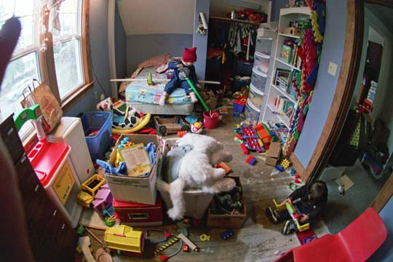

Slide 2
Helping Hands Helping you, help yourself.
Joshalyn Burgos
Grade 11
16 years old

Slide 3
What’s the problem?
Working parents have difficulty balancing work, childcare, and maintaining an efficient household
We organize FOR you more efficiently
Demonstrate how to maintain organization
Use aesthetically pleasing décor
Notes:
In a survey done outside of school, given to working parents 86% of them responded that their house feels unorganized some of the time to most of the time. Having an unorganized home results in a loss of efficiency. Helping Hands will solve the problem, as well maintain the upkeep of your newly organized home.

Slide 4
What’s our solution?
Providing hands on, in-home organizing services
Using organization to provide a more efficiently running household
Services offered in contract, or single organized
Contracts offered in three month spans, single jobs used for big occasions

Slide 5
Description of Product/Service
This service allows me to go to your home and organize whatever is needed. Whether it be a room, closet, or cabinet
My organizational methods are also charming, and modern, using trendy items
It is efficient and convenient
Get help creating systems for your everyday challenges
Bring order, calm, and control to your home and family life
Includes a consultation so we can cater to your needs, as well as work around your family schedule and lifestyle
Notes:
An ancient proverb once said, Cleanliness is next to Godliness. Well the same holds true for organizational. To get the most out of your home, its great to have an organized space. Find what you need, when you need it. Go on to text!

Slide 6
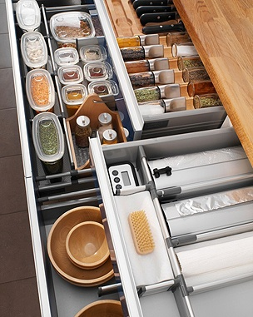
Business Model
Definition of One Unit
A full kitchen Organize
Economics of One Unit
Selling Price |  | $350.00
Cost of materials | $34.00
Cost of labor | $57.75
Other variable costs | $00.00
Total COGS/ COSS |  | $91.75
Contribution Margin |  | $258.25
Monthly Break Even Units
$566.00 | = | 2.192 | ≈ | 2 units
$258.25
Notes:
If I were to do someone's kitchen, which would average seven hours including consultation time, and transportation time. I included basic materials, such as three wicker baskets, and labels, all together costing $34. Charging minimun wage, or $8.75 an hour my labor costs $57.75. ALL together it costs me $91.75 to do the whole room. Icharge $350, to make a contribution margin of $258.25. Value added is organized space, peaceful state of mind, and efficiency.

Slide 7
Market Analysis
Market Statistics
Industry Name: | Consumer Services | Annual Industry Sales: | $$1 Billion
Description of Target Consumer
Demographics | Geographics
Busy families with annual incomes of $60,000 +, college education, may be stay at home mothers | Geographic Information: My customers are expected to live in the Greater-Hartford area, this includes Hartford, and the surrounding Suburban areas. They shop at popular groceries store, like Stop and Shop, and go to family centers like parks, and YMCA’s
Psychographics | Buying Patterns
Conservative families, with a middle-class to wealthier lifestyle. They hire people to help with the upkeep of their home, (gardeners, nannies, maids). Makes them more likely to hire a business like mine to come into their home | Hiring maids, nannies, to come several times a week, or paying for daycares
Target Market Size
Total population of targeted geographic area
[1,059,870
Population of target market
347,205
Market size
(based on
survey)
100,000

Slide 8
Promotion and Sales
Newsletters
E-mails, as well as handouts in my community
Business Cards
Passed out to potential clients, for further contact
Word of mouth
Advertising by speaking to friends, and asking them to promote it as well
Website
Informational, provides contact information
Pamphlets
Provide more in-depth information for possible customers

Slide 9
Competition
Direct Competition
Merry Maids
Home Cleaning Solutions
Strengths/Weaknesses
Come to your house, have experience.
Don’t provide personalized service
Indirect Competition
Home organizational supplies
HGTV
Strengths/weaknesses
Only have supplies, not actual instructions
How do I stand apart?
By having a consultation, and making myself familiar with your home, and family life, I really am providing “personalized” service. We customize organization, to match YOUR everyday challenges and needs.
Notes:
My direct competition would be Merry Maids, and Home Cleaning Solution, because they are both service buisnesses as well. However, all they do is clean versus my extra step of organizing the home. Indirect competitors are home organizational supplies, which can be found in Lowe’s or Home Depot, as well as finding organizational tips.

Slide 10
Qualifications
Have been in charge of cleaning and maintaining my household for the past 4 years. I have researched many different methods for organizing that are efficient, yet fun.
Great sales and customer skills
Plan on becoming operational after completion of high school
Took a Marketing and Entrepreneurship class

Slide 11
Sales Projections
Total Units
54
Gross Revenue
$18,900
Net Profit
$12,102

Slide 12
Startup Funds
Item | Why Needed |  | Cost
Label Maker | For organizing |  | $35.00
Agenda | For scheduling |  | $12.00
Website Design | For advertising |  | $50.00
Laptop | For record keeping |  | $0.00
DBA | For legal purposes |  | $15.00
Workspace Car | To handle business, and hold files For transportation |  | $0.00 $0.00
Buisness Cards Pamphlets | Promotions Promotions |  | $10.00 $2.00
 | Total Startup Expenditures |  | $124.00
 |  | Emergency Fund | $62.00
 |  | Reserve for Fixed Expenses | $1698.00
 |  | Total Startup Investment | $1878.00

Slide 13
Helping Hands Helping you, help yourself.
Thank you for your consideration.
Joshalyn Burgos

