Slide 1
Lacey Hernandez
14 years old
9th grade, Washington HS

Slide 2
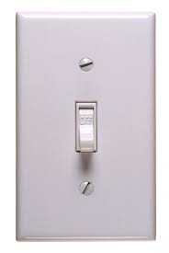
Imagine a world with no taste…

Slide 3
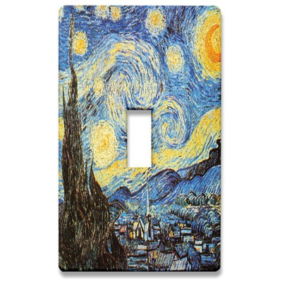
Awesome quality.
Great service.
Unique styles.

Slide 4
Mission and Social Impact
Mission Statement:
Litswitchkins will provide our customers with unique, cute, and customizable light switch panels. We will try to make the customer experience as memorable as possible, while selling at low prices, providing great service, and delivering awesome quality.
Social Impact:
Litswitchkins re-uses old materials and recycles paper waste as part of its business model

Slide 5
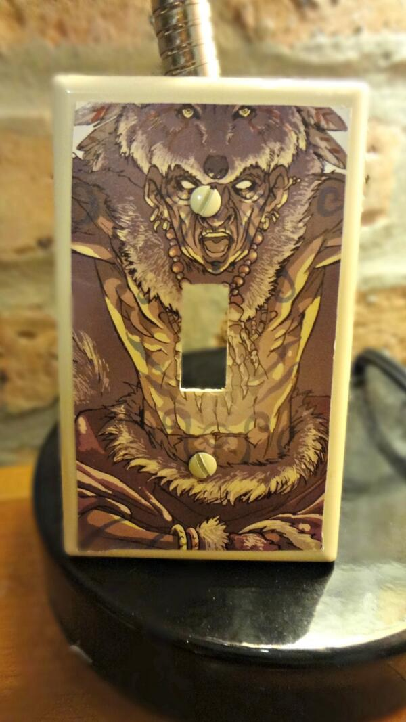
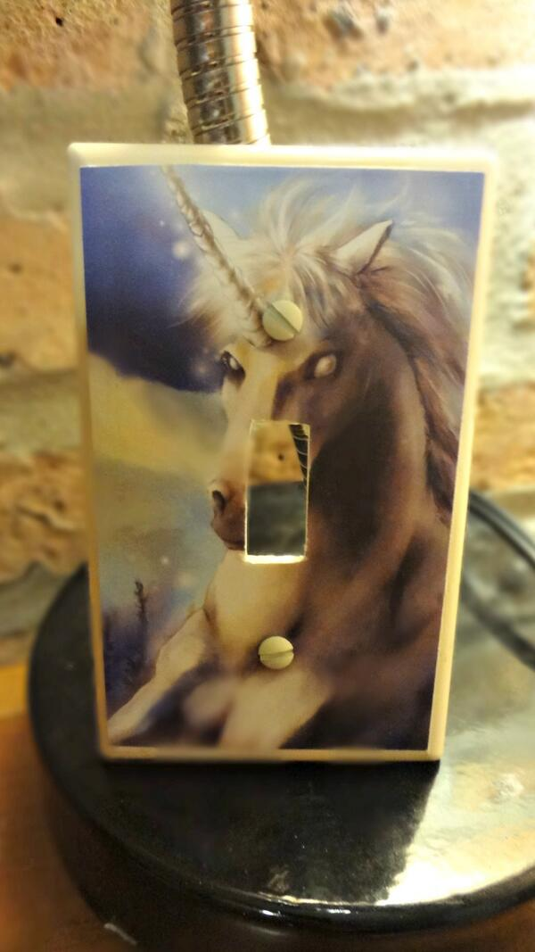
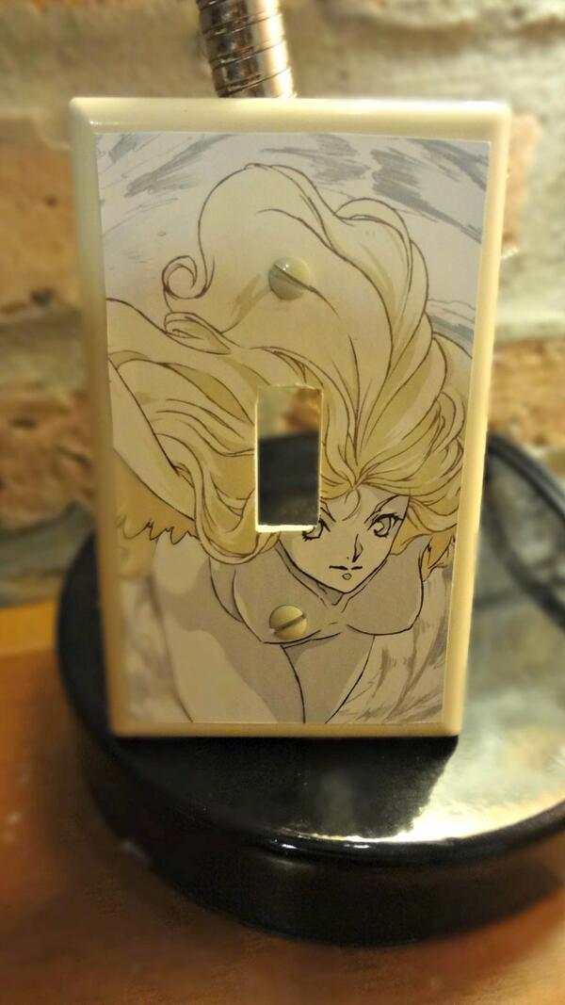
Customer Benefits
Convenient
Customizable
Unique
Fun
Great Quality
Simple
Expressive
Bold
Inexpensive

Slide 6
Business Model
 | Description of One Unit of Sale | 1 Wall Plate
 | Selling Price Per Unit | $15.00
 | COGS | $6.50
 | Other Variable Expenses (Per Unit) | $2.00
 | Total Variable Expenses (Per Unit) | $8.50
 | Contribution Margin (Per Unit) | $6.50
Description of Expenses
Variable Expenses | Total: $8.50
Materials | $4.00
Labor | $2.50
Packaging & Shipping | $2.00
Fixed Expenses | Total: $120
Insurance | $15.00
Salary | $20.00
Advertising | $45.00
Utilities | $20.00
Rent | $20.00
Fixed Monthly Expenses | $120.00 | 19
Contribution Margin Per Unit | $6.50 | Break Even Units

Slide 7
Market Analysis
Market Statistics
Industry Name: | Home Decorations | Annual Industry Sales: | $130,232,430,000
Description of Target Consumer
Demographics | Geographics
Professional families Income of $50,000+ | Columbus area
Psychographics | Buying Patterns
Artsy Creative Hard Working Spend time working on home | $100 every two weeks $200 every month 20% of people surveyed would definitely buy the product
Target Market Size
Total Population
1,836,536
Target Market Population
947,799
Market size
(based on
survey)
189,560

Slide 8
Competition
 | Litswitchkins | Wall Plate Warehouse | Switch Plate Superstore | SwitchHits
Price | Inexpensive | Medium | Medium | High
Variety | Unique & Stylish | Lacks Variety | Lacks Creativity | Wide Variety
Customization | CUSTOMIZABLE | NOT CUSTOMIZABLE | NOT CUSTOMIZABLE | NOT CUSTOMIZABLE
Litswitchkin’s Competitive Advantages
1. CUSTOMIZABLE – Allows customers to be creative; Focus on the customer experience 2. Best quality! Unique & Stylish 3. Inexpensive – Best value!

Slide 9
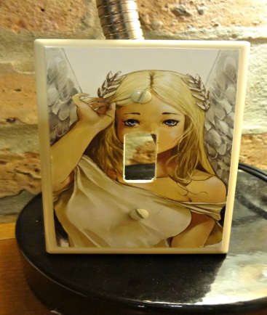
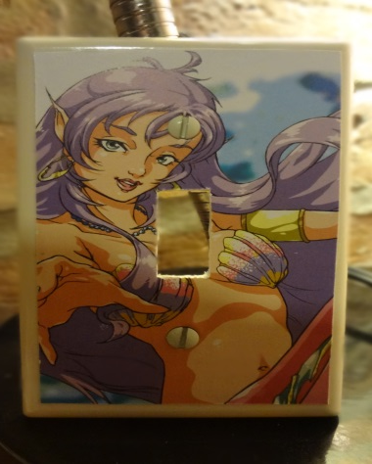
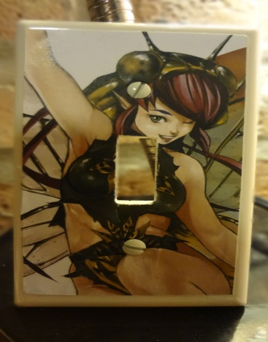
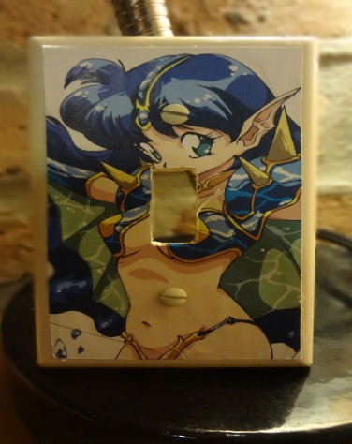
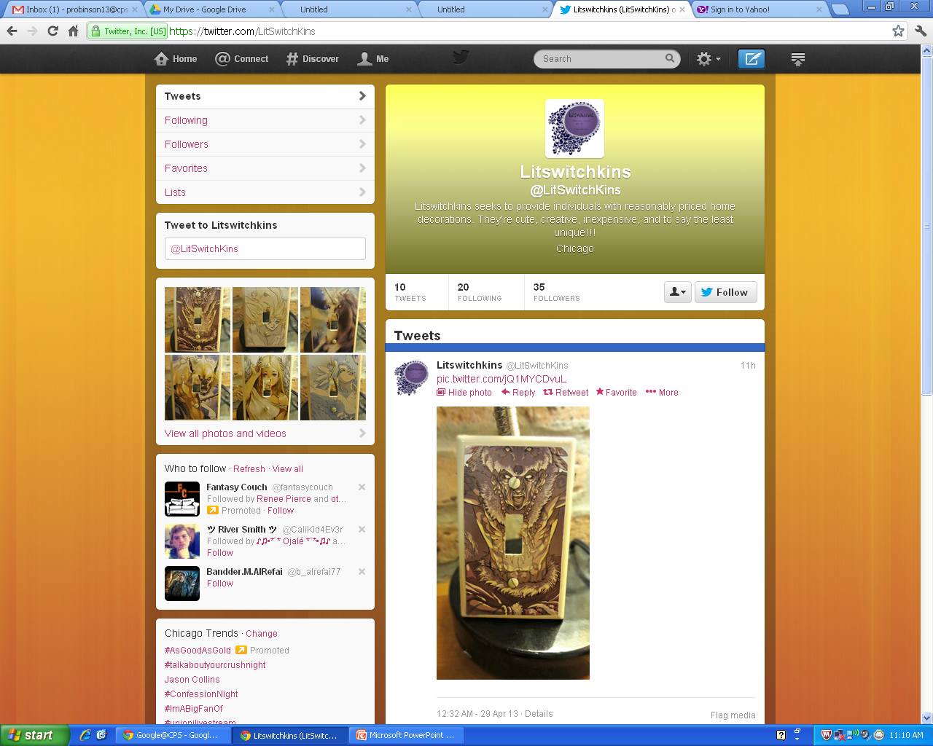
Marketing & Sales
Twitter Account: @LitSwitchKins
YouTube
Etsy.com
Art Fair
Buy 2 get 1 half-off

Slide 10
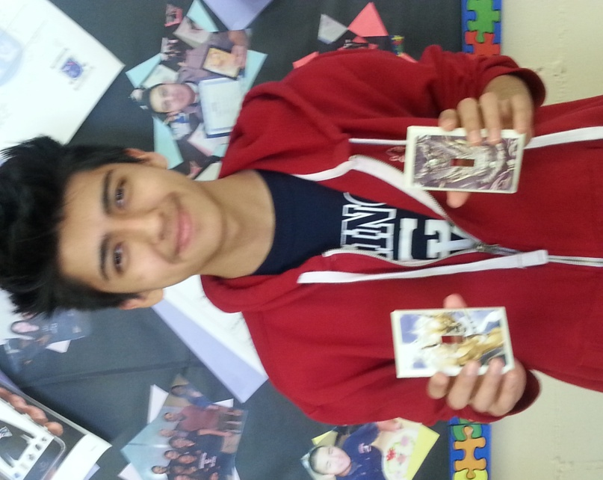
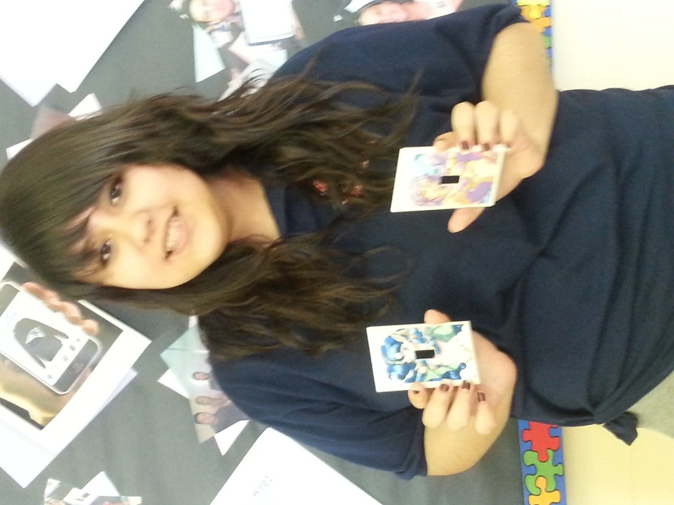
Qualifications
Intensive, year-long business class
Attended NFTE business camp
Creating original and beautiful products

Slide 11
Projections
Total Units:
983
Revenue:
$14,745
Net Profit:
$4,207.08

Slide 12
Investment Opportunity
Items | Explanation | Vendor | Cost
Telephone | In order to communicate with potential clients | AT&T | $100
Computer | Online Marketing | AT&T | $300
Light switch panel | To be able to create designs | Home Depot | $50
Paint | To paint the light switch panels | Target | $50
Painting tools | To paint designs | Target | $50
 |  | Total Expenditures | $550
Emergency Fund | Unexpected expenditures | ½ of start-up | $275
Reserve for fixed Expenses | I don't expect to break even for the first three months | 3 months of fixed expenses | $360
 |  | Total Start-Up | $1,185
Annual Net Profit | $4,207.08 | 29%
Total Annual Sales | $14,745 | ROS%
Annual Net Profit | $4,207.08 | 355%
Total Start-Up | $1,185 | ROI%

Slide 13
Future Plans
Options to Scale
Consultations with customers
Online store
Partner with home décor stores
Start designing other decorations
Giving Back
Partner with charities
Year 1 | Year 2 | Year 3
Projected profits: $4,207 | Projected profits: $8,414 | Expand product offerings

