Slide 1
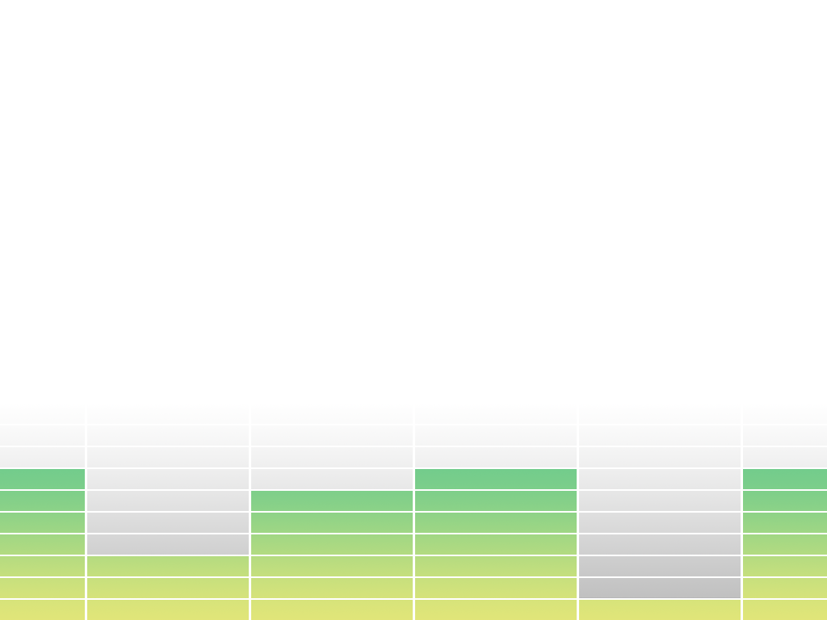

Slide 2
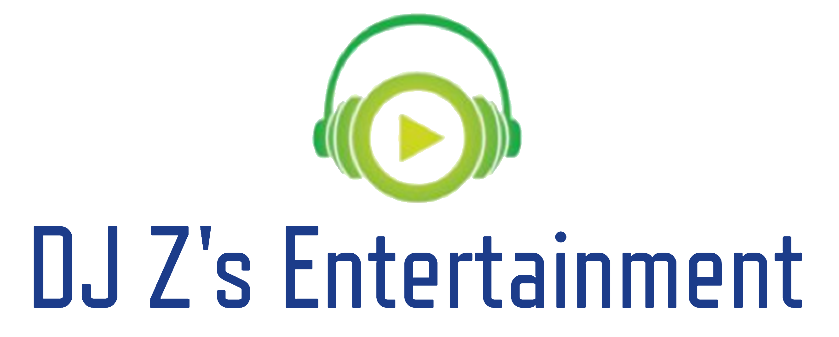
Zachary Barletta
16
Pathways to Technology

Slide 3
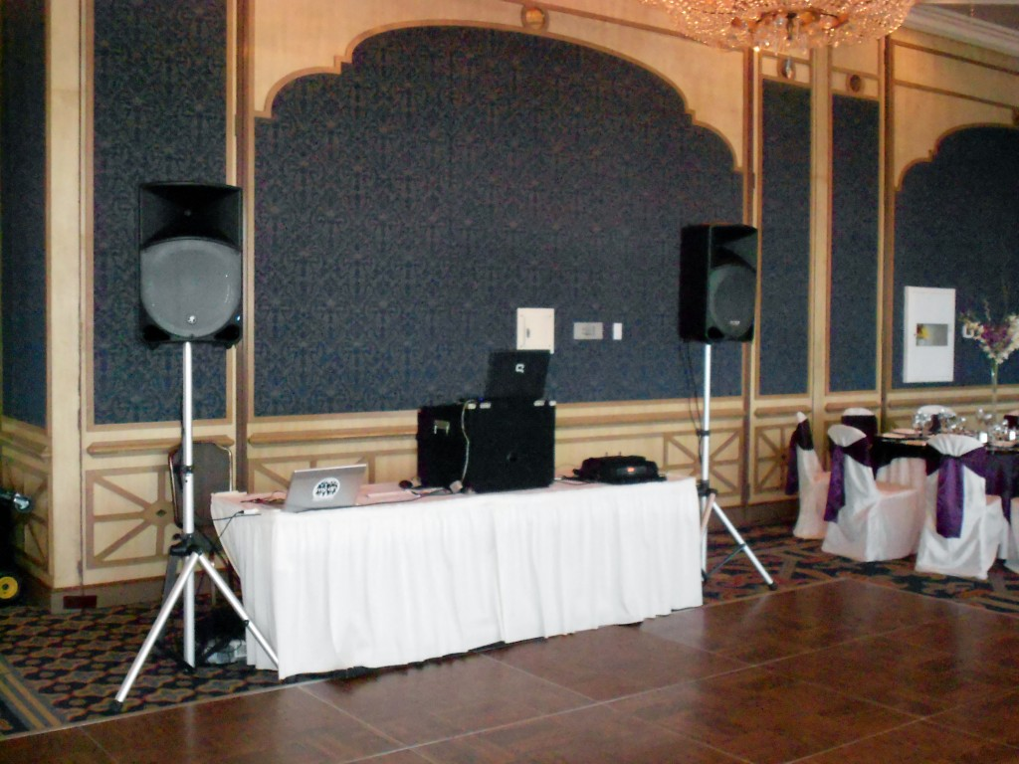
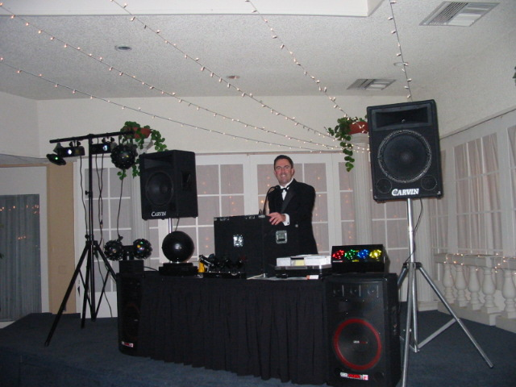
Problem
DJ’s are not coming prepared
Boring setup = Boring events = Unhappy customers

Slide 4
Solution

Slide 5
Mission Statement
Mission Statement:
DJ Z’s Entertainment works towards providing great service for small, medium, and large events, for guests of all ages.
Using an experienced event team, and taking advantage of others in the industry, DJ’s Entertainment vows to stop at nothing in order to provide our clients with the best services.

Slide 6
Suppliers
High end event furniture rental
Concert level sound and lighting equipment

Slide 7
My Services

Slide 8
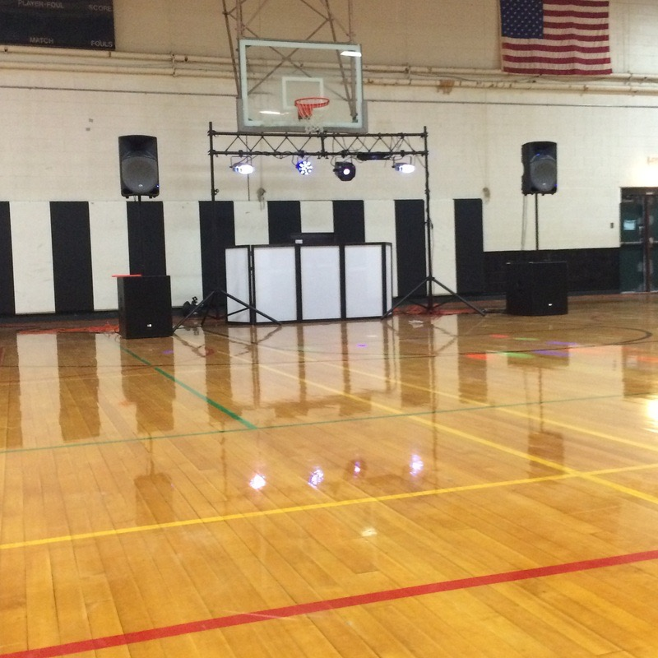
Full size set up: 4 Speaker sound system Full LED lighting rig

Slide 9
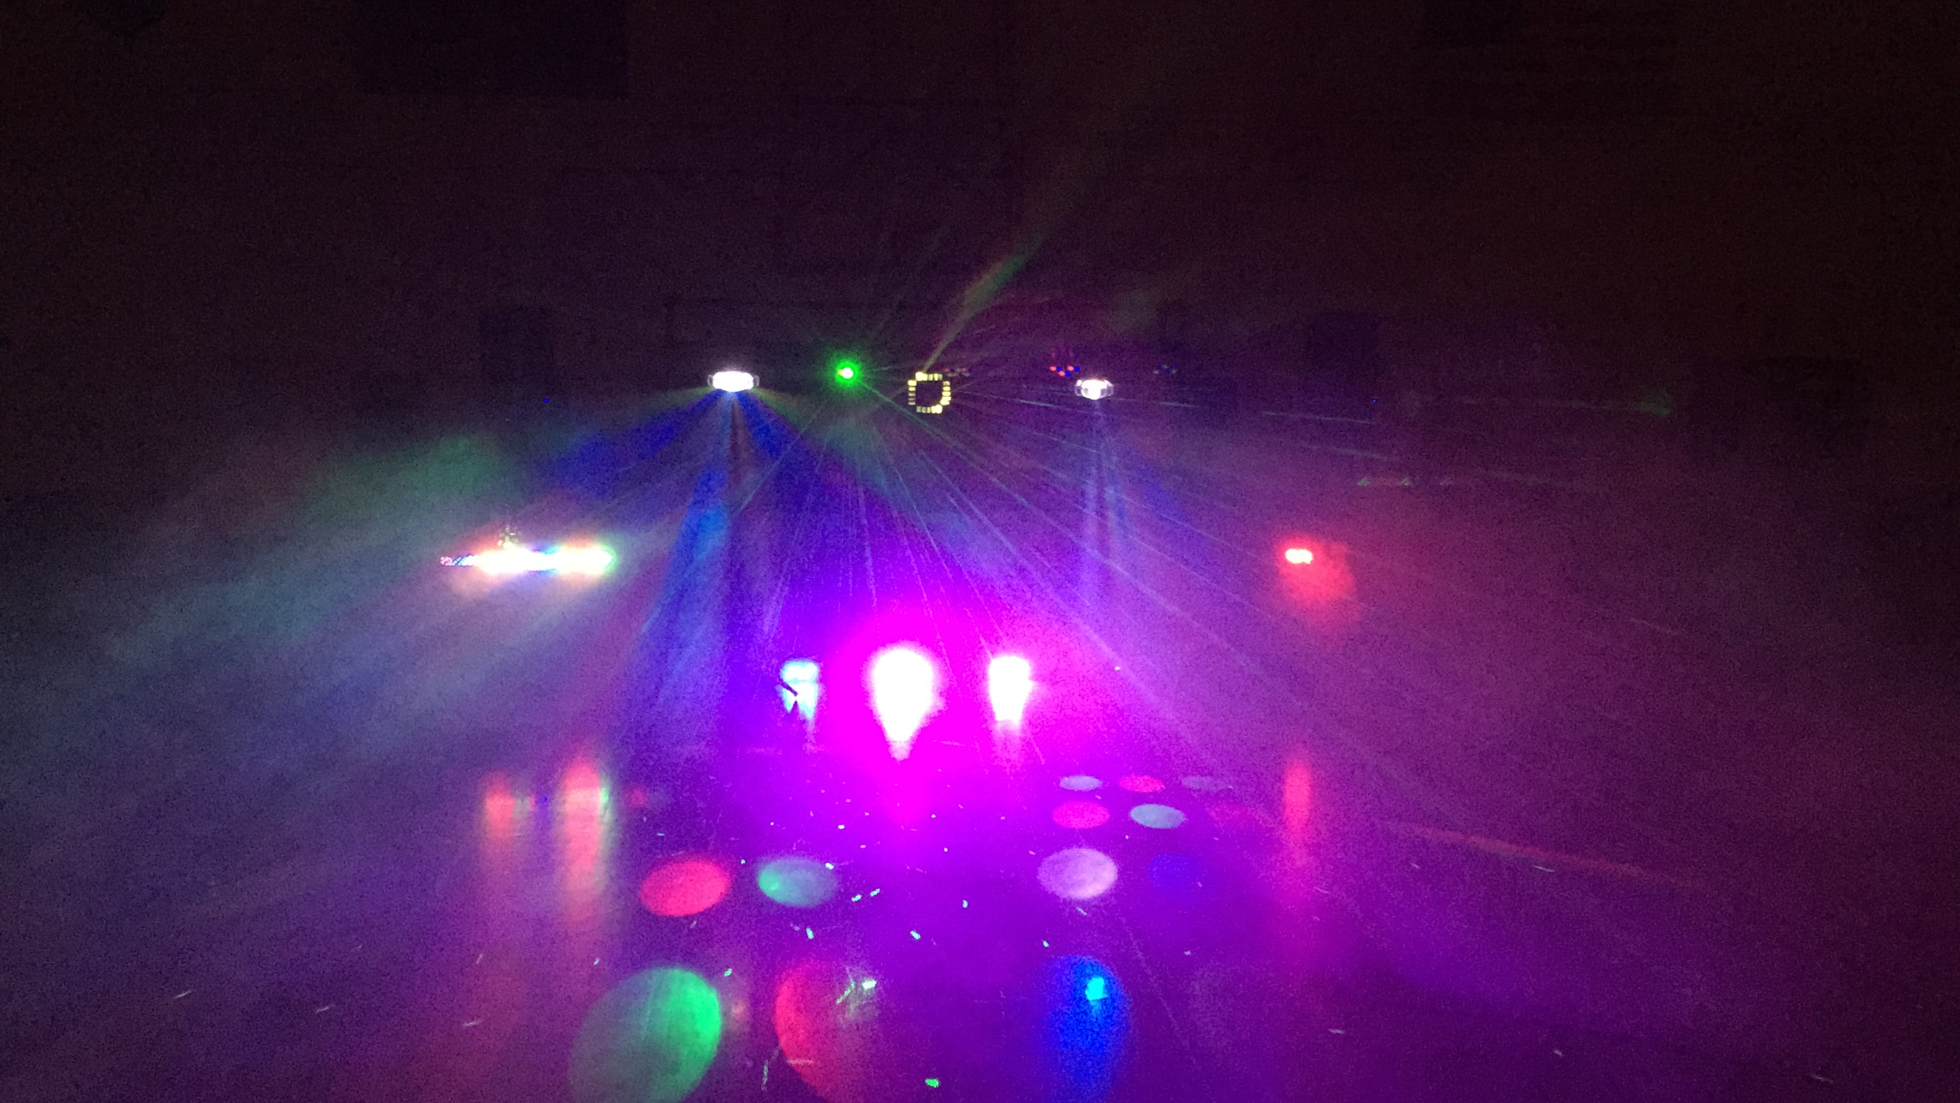

Slide 10
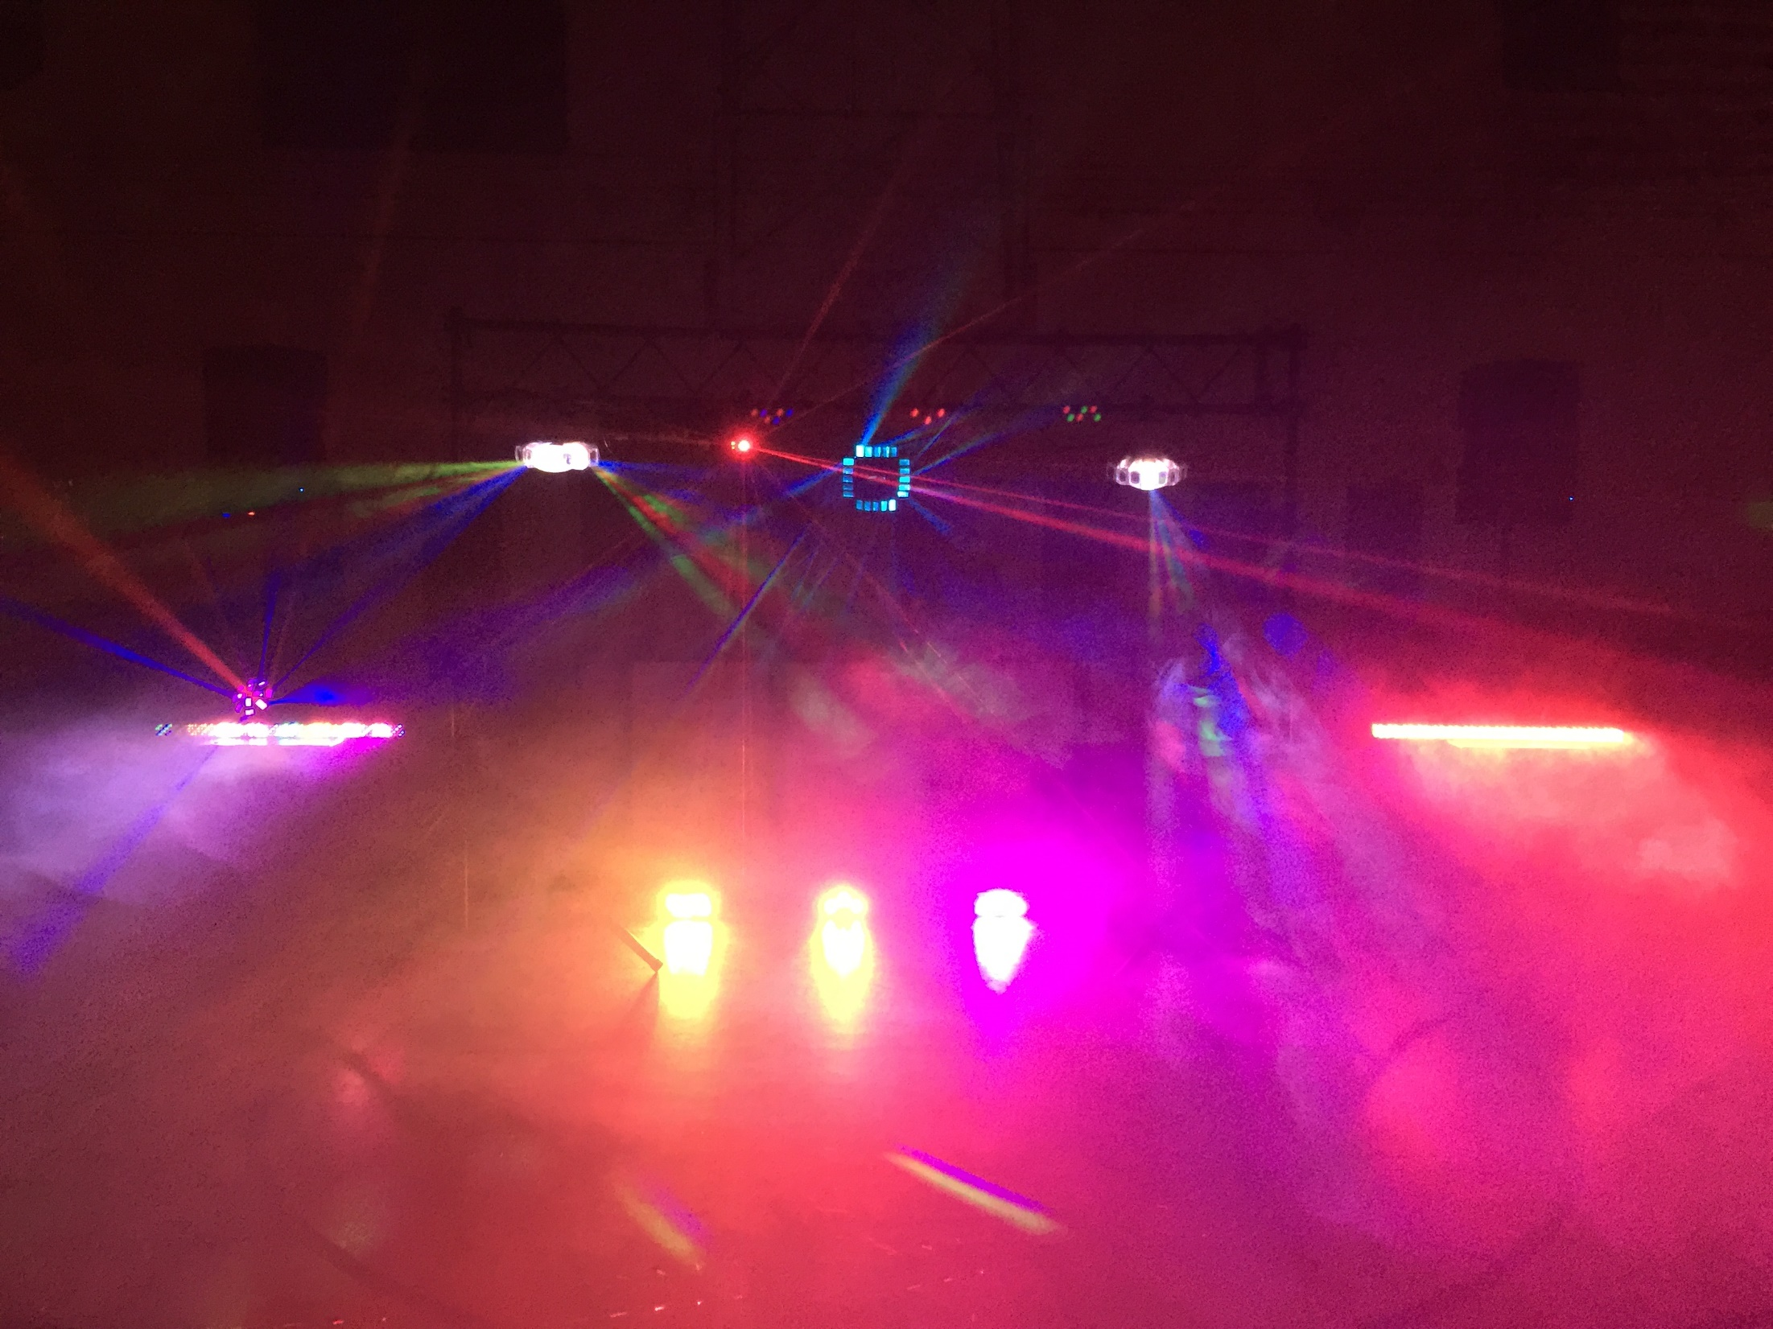

Slide 11
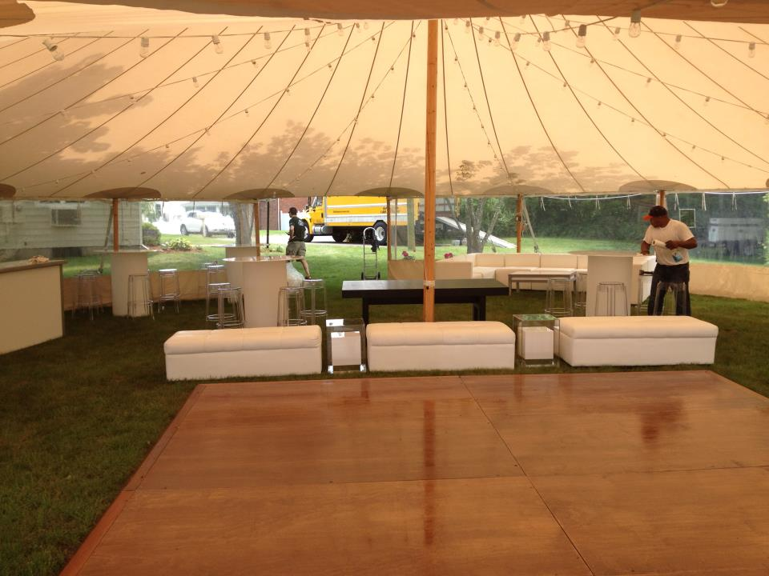

Slide 12
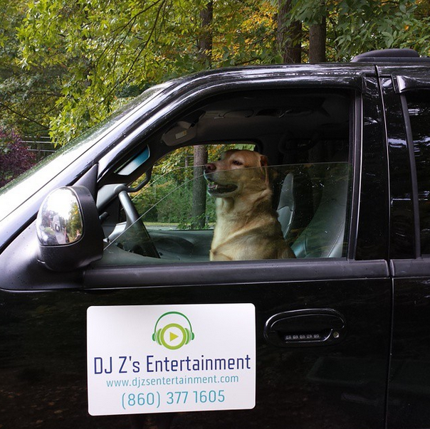

Slide 13
The Results
“We hired DJ Z’s Entertainment to provide music for one of our dances at the Lebanon Middle School. Zack was punctual and professional and he also brought with him a wide variety of lights and special equipment to entertain our students. They truly enjoyed the music he played and had a great time. I would wholeheartedly recommend Zach to DJ any event, big or small!”
Barbara Archer
Lebanon Middle School
Student Council Advisor

Slide 14
Business Model
Definition of One Unit
Basic Event
Description of Expenses
Variable Materials | Total: $200
Equipment Rental | $75
Transportation | $25
Labor | $100
Fixed Expenses | Total: $30
Software License | $10
Record Pool | $10
Web Hosting | $10
Economics of One Unit
Selling Price |  | $350
Cost of var. materials exp. | $75
Cost of labor | $100
Other variable costs | $25
Total COGS/ COSS |  | $200
Contribution Margin |  | $150
Monthly Break Even Units
$30 | = | 0.2 | ≈ | 1 Event
$150

Slide 15
Market Analysis
Market Statistics
Industry Name: | Events/Entertainment | Annual Industry Sales: | $4 Billion
Description of Target Consumer
Demographics | Geographics
School Systems Parents of Teens | New London and Windham Country, Greater Hartford County Area.
Psychographics | Buying Patterns
Those looking for an easy way to entertain part guests. | Population with discretionary funds.
Target Market Size
Total Population
3.597 Million
Total Market Population
1.03 Million
Market Size
150 k

Slide 16
Spreading The Word
Venue Visits
Interact directly with future clients
Email Blasts
Not only to gain clients, but to inform existing
Postcards
Small/Low Cost advertisements
Social Media
Follow us on Twitter & Instagram: @DJZsEntertain
Word of Mouth
Advertisement at no cost!

Slide 17
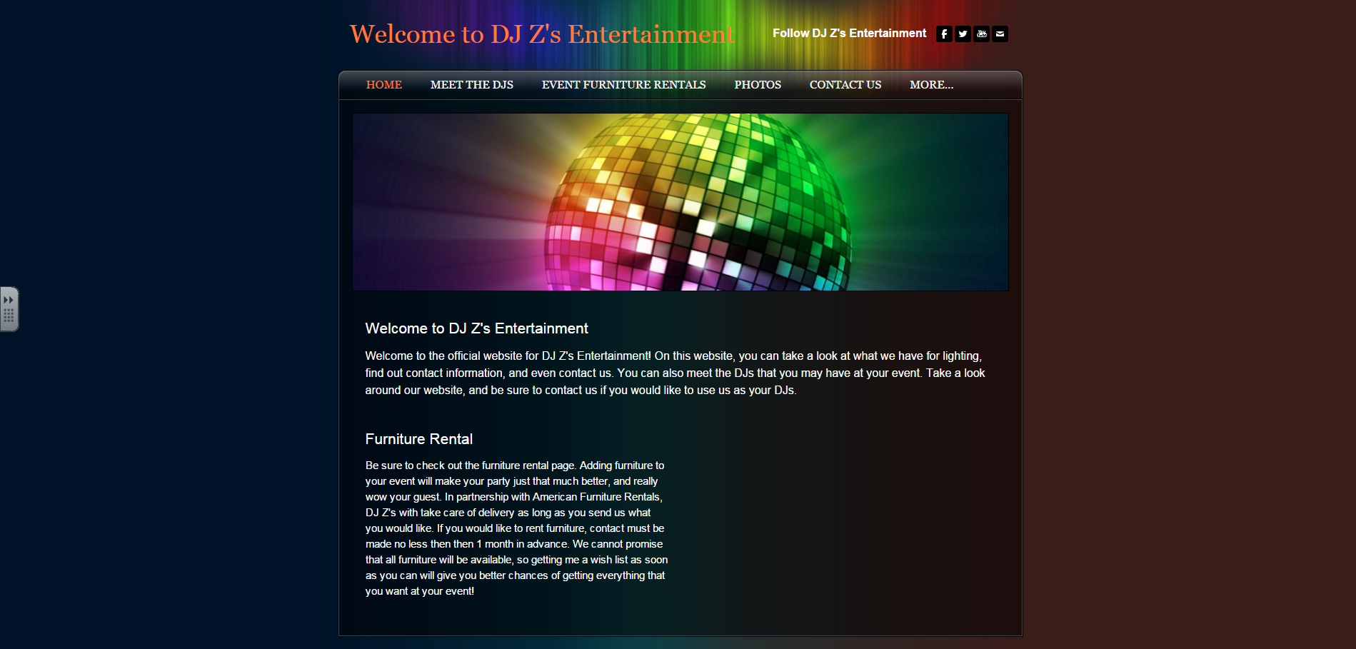

Slide 18
Competition
 | Sounds in Motion DJs | Boppers Entertainment | DJ Z’s Entertainment
Quality | Controls Hartford market | Head-to-head competitor | Newer business with new ideas
Unique Factors | Larger amount of resources | Well known in the market | Specialize in teen events
Reputation | Involved in NY, RI, and NJ market | Providing service for 20 years | Handles events large and small
Competitive Advantages
1. Local business feeling. 2. Low/no cost non-profit work. 3. Competitive rate match.

Slide 19
Qualifications
Have been a DJ for 5 years
Completed numerous classes on digital media/sound production
Taught sound production to middle school children (Summer of 2014)
Completed the NFTE Entrepreneurship course

Slide 20
Sales Projection
Total Units
39
Gross Revenue
$13,650
Net Profit
$5,850

Slide 21
Future Plans
Expand to full service events
Provide event enhancements
Food Machines
Arcade Games
Inflatables
Move my company into Nashville, Tennessee
Larger Market
Passion for Country Music

Slide 22
Thank you for your consideration!
© 2015 DJ’s Z Entertainment. Designed by IS DESIGNS. All Rights Reserved

