Slide 1
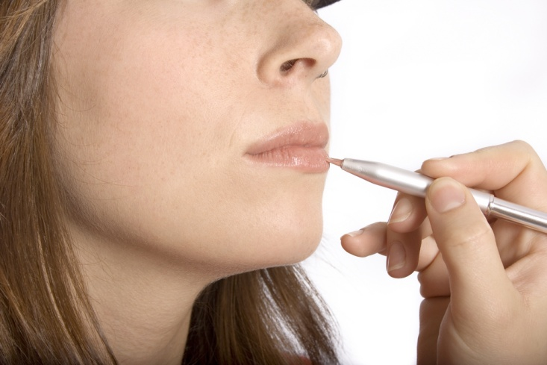

Cosmetics
Beauty from the Earth
Beverly Bainbridge
Age: 28

Slide 2

Mission Statement
Mission Statement
  Beauty from the Earth manufactures cosmetic products for the skin, hair, and nails that are made from natural ingredients from the American southwest. Our manufacturing process is environmentally friendly, with no animal testing.
  Opportunity
  The southwestern U.S. has an abundance of plants that have long been cultivated for health and beauty reasons. Research institutions are now beginning to realize the potential health and beauty benefits of these plants.
  Health-conscious people have migrated from the fringe to become the mainstream market over the past 10 years. They are a large potential market for our products.

Slide 3
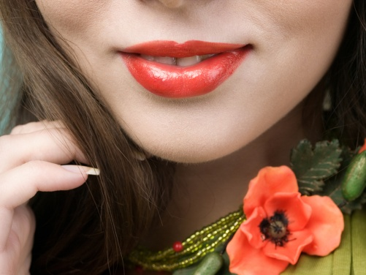
Business Profile
Type of Business
  Beauty from the Earth is a manufacturing company developing cosmetic products for health-conscious consumers in an environmentally friendly way.
  Legal Structure
  Beauty from the Earth is a sole proprietorship. I chose this status because of the ease of set-up, the low set-up costs, and the ease of maintaining the company.

Slide 4
Qualifications
I’m qualified to run this business because:
  ❶
  ❷
  ❸
I am a graduate of the New Mexico School of Natural Therapeutics with certificates in Cosmetology and Massage Therapy.
I am a master herbalist, the author of numerous articles, and conduct workshops on the use of herbs and plants in beauty and health.
I have five years’ experience creating and selling herbal cosmetics from a home-based business.

Slide 5
Market Analysis
Industry Name | Health and Beauty Care Industry
Industry Size | $56 Billion (U.S. Market)
Total Population | Households in Albuquerque, NM, and surrounding area
Target Market | Females over 15 years old in households with a household income over $35,000
Potential Market | Above households with females who have a “Lifestyle of Health and Sustainability” (LOHAS) sensibility
Total Population
183,625
Target Market
99,920
Potential Market
16,986

Slide 6

Target Market Segment
Demographics
  Females over 15 years old in households with household income over $35,000
Geographics
  Greater Albuquerque, NM, area
Psychographics
  Have a Lifestyle of Health and Sustainability (LOHAS) sensibility.
  Buying Patterns
  Buys green products, interested in sustainability, health-conscious, but also interested in looking good. Reads about cosmetic purchases before buying. Brand conscious and discriminating.

Slide 7
Competitive Advantage
Beauty
from the
Earth
Celestial
Sunshine
Botanical
Health
Factors
Price
$72/case of 12
$125/case of 12
$99/case of 12
Quality of
Product/Service
Organic plants from the Southwest
Ingredients from all over the world; not organic.
Organic plants from the East Coast.
Location
Albuquerque,
NM
Oakland, CA
Poughkeepsie, NY
Reputation/Brands
New to market
Well known, in business 20 years
In business 5 years. Went national last year.
Unique Factors/
Knowledge
Uses only organic Southwestern ingredients.
Uses ingredients from all over the world.
Uses organic ingredients from the East Coast.

Slide 8

Marketing Mix
People
Product
Place
Price
Promotion
Focus on females over 15 in households with an annual household income over $35,000 who have a LOHAS sensibility
Customers in the greater Albuquerque, NM, area
Local advertising, in-store demos, workshops, brochures and flyers, Website, viral marketing
Natural, organic cosmetics for the skin, hair, and nails
$6/product (Case of 12 for $72)

Slide 9
Promotional Mix
Promotional Expense
Monthly
Amount
Advertising
Brochure (and postage), cards, Website development
$262
Publicity
Press releases, postage
$5
Personal Selling
Educational workshops at colleges; in-store demonstrations.
—
Sales Promotion
———
—
Other
Social networking sites, daily blog on Website
—
Total Monthly Promotional Expense
$267
Notes:
Student Notes:
Promoting Your Product is covered in Section 8.2 (pgs. 223-232).
The principles of personal selling are covered in Section 9.1 (pgs. 239-247).
The Total Monthly Promotional Expenses will be shown on the “Average Monthly Fixed Expenses” slide, under “Advertising.”
Write keywords about your plan for using a particular type of promotion in the spaces provided. Show only the types of promotion you will be using. So, for instance, if you don’t plan on using “Sales Promotion,” don’t include it on your slide.
Other Types of Promotional Expense
This includes visual merchandising, public relations, and any other type of promotion not covered by the first four types.
Business Plan Exercises
This slide relates to the following business plan exercises:
Section 8.2: “Promotional Mix.” In BizTech or pgs. 281-287 in the Business Plan Project (Student Activity Workbook).
Section 9.1: “Selling Your Product or Service.” In BizTech or pgs. 288-290 in the Business Plan Project (Student Activity Workbook).
Teacher Notes:
Students may need help reducing their concepts to the relatively small boxes. Explain that they are key words which students will more fully explain as they give the presentation.
Related Experiential Exercises
“Mock Sales Call.” Teacher’s Wraparound Ed., pgs. 240-241.
Other Activities
“Guest Speaker.” Invite a guest speaker who is a specialist in marketing or advertising to speak to your class. Ask your Program Officer to help recruit the speaker.
“Brainstorming: Types of Promotion.” Have students brainstorm the advantages and disadvantages of publicity, advertising, and online marketing.
“Press Releases.” Have students review newspapers, particularly local ones, for articles that they think were written from press releases. Discuss the articles as a class.
“Commercials.” Ask students to create 30-second commercials illustrating the benefits of each media type.

Slide 10
Cost of Materials/Labor
Materials
Material Description | Cost/Total Quantity | Cost per Unit
Herbs, plants | $21 | $21
Base liquid | 6 | 6
Jar/bottle, adhesive label | 3 | 3
Total Material Cost per Unit |  | $30
Labor
Labor Cost per Hour | Time (in Hours) to Make One Unit | Labor Cost per Unit
$12.50 | 1 | $12.50
Total Labor Cost per Unit |  | $12.50
COGMS (per Unit) | $42.50
Notes:
10

Slide 11
Economics of One Unit
Description of One Unit of Sale:
One box containing 12 products
Selling Price (per Unit) | $72.00
COGMS (per Unit) | 42.50
Other Variable Expenses (per Unit) | 0.50
Total Variable Expenses (per Unit) | 43.00
Contribution Margin (per Unit) | $29.00

Slide 12
Average Monthly Fixed Expenses
Fixed Expense | Average Monthly Expense*
Insurance | $250
Salaries of Employees | 4,500
Advertising | 267
Interest | —
Depreciation (Computer, Printer, Lab Equipment) | 75
Utilities (Gas, Electric, Telephone) | 205
Rent | 800
Other Fixed Expenses | —
Total Average Monthly Fixed Expenses | $6,097
* Numbers are rounded to the nearest dollar throughout.

Slide 13
Time-Management Plan
Schedule for a Typical Week
Total Hours in a Week = 168

Slide 14
Monthly Sales Projections
First Year
Total Units Sold
2,800

Slide 15
Monthly Break-Even Units
6,097
=
210.24
29
In an average month, the company will begin to make a profit after selling units.
210

Slide 16
Projected Yearly Income Statement
First Year
Selling Price per Unit | $72
Number of Units Sold | 2,800
Total Sales |  | $201,600
Variable Expenses | 120,400
Contribution Margin |  | 81,200
Fixed Operating Expenses | 73,134
Pre-Tax Profit |  | 8,036
Taxes @ 15% | $1,205
Net Profit |  | $6,831

Slide 17
Start-Up Investment
Start-Up Expenditures
Item | Where Will I Buy This? | Cost
Lab Equipment | On-Line | $2,802
Materials | Local Vendors & Growers | 12,750
Total Start-Up Expenditures |  | $14,552
Cash Reserves
Emergency Fund | $2,255
Reserve for Fixed Expenses | 12,193
Total Start-Up Investment
$30,000

Slide 18
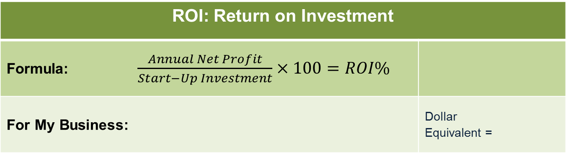
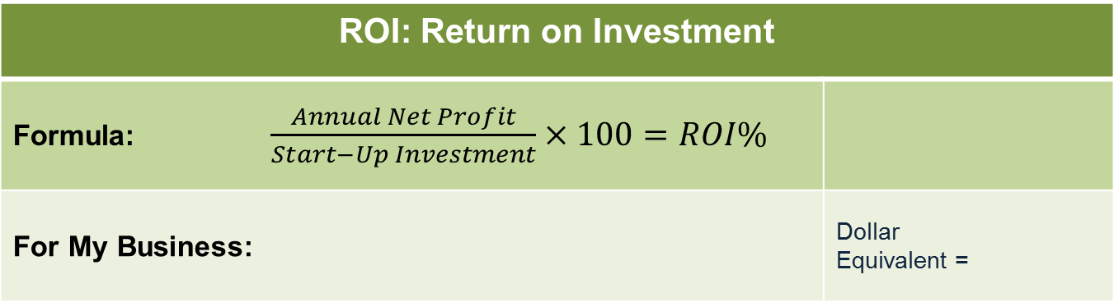
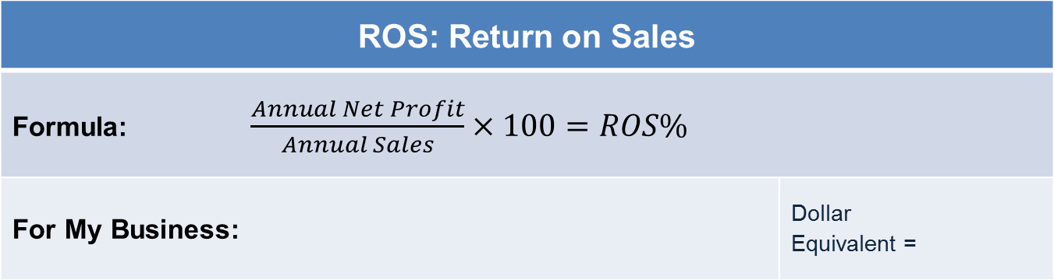
ROS & ROI
ROS: Return on Sales
For My Business: | Dollar Equivalent =
$6,831
$201,600
X 100 =3% ROS
$0.03
ROI: Return on Investment
For My Business: | Dollar Equivalent =
ROI: Return on Investment
For My Business: | Dollar Equivalent =
$10,241
$5,000
$6,831
$30,000
X 100 =205% ROI
X 100 =23% ROI
$0.23

Slide 19
Financing Strategy
Total Start-Up Investment
$30,000
Source | Amount | Debt | Equity | Gift
Personal Savings | — |  | —
Relatives/Friends | — | — | — | —
Investor (Bank) | $30,000 | $30,000 | —
Partner(s) | — | — | —
Totals | $30,000 | $30,000 | — | —

Slide 20
Business Responsibility
& Philanthropy
Business Responsibility
  Use organic, locally grown and harvested plants whenever possible.
  All non-local ingredients will be secured from organic supplies using earth-friendly, sustainable business methods.
  Products will be created in an environmentally friendly manner, with no animal testing.
Philanthropy
  Contribute 1% of yearly net profit (after 3 years of business) to nonprofits assisting indigenous peoples in the American Southwest.

Slide 21
Business & Personal Goals
Business
Personal
  Establish a profitable local customer base.
  Have our products carried by every health-oriented shop within 100 miles of Albuquerque.
  Locate people in the Southwest who have retained knowledge of the traditional uses of local plants and ask to be trained by them.
Short-Term
  By our third year, hire a full-time Director of Marketing.
  In the third year, take the company’s product line nation-wide.
  Sell to national health-oriented store chains and regional distributors.
  Sell one-third of our products via the Internet.
  Write a book about the traditional uses of native plants.
  Reduce my role in Sales in the third year.
  Look for opportunities to educate people about the traditional uses of local plants, both to benefit the business and the population at large.
Long-Term

Slide 22
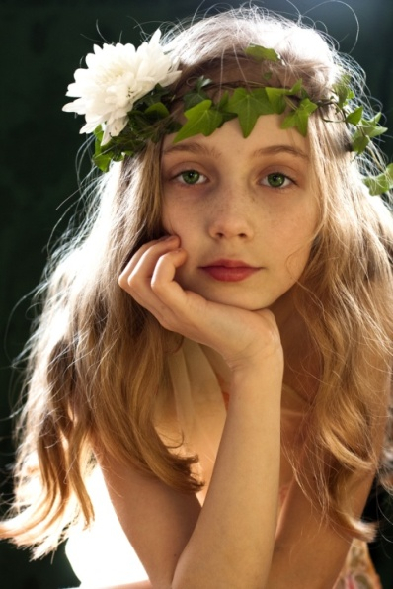
Back to Basics Beauty, in Harmony with the Earth
Beauty from the Earth
Would like to say “Thank You”
for your consideration.

